Slide 1
Illustrating HIV/AIDS in the United States
2015 Update

Slide 2
About AIDSVu
AIDSVu is a compilation of interactive, online maps that allows users to visually explore the HIV epidemic in the U.S. alongside critical resources such as HIV testing and treatment center locations.
AIDSVu’s mission is to make HIV prevalence data widely accessible and locally relevant.
AIDSVu provides users with an intuitive, visual way to connect with complex information about persons living with an HIV diagnosis at national, state and local levels.
Notes:
AIDSVu is a compilation of interactive, online maps that allows users to visually explore the HIV epidemic in the U.S. alongside critical resources such as HIV testing and treatment center locations.
AIDSVu’s mission is to make HIV prevalence data widely accessible and locally relevant.
AIDSVu provides users with an intuitive, visual way to connect with complex information about persons living with an HIV diagnosis at national, state and local levels.

Slide 3
Interactive Maps
National, State, and Local Maps
Persons living with an HIV diagnosis by state, county, ZIP Code, census tract, and neighborhood
Persons newly diagnosed with HIV by state and county, year-by-year
Social determinants of health (e.g., poverty, insurance, education)
HIV transmission modes
Service Locators
HIV testing and treatment center locations
NIH-funded HIV Prevention, Vaccine & Treatment Trials Sites
Housing Opportunities for People with AIDS
Notes:
AIDSVu uses data from multiple trusted sources to populate its interactive maps.
In order to be able to compare data between jurisdictions, AIDSVu’s state- and county-level data about persons living with an HIV diagnosis come from the U.S. Centers for Disease Control and Prevention (CDC). ZIP Code, census tract, and neighborhood data come directly from jurisdictions’ health departments. AIDSVu data do not reflect undiagnosed cases.
Other data available on AIDSVu include:
Social determinants of health data at the state and county level
HIV testing and treatment center locations
NIH-funded HIV Prevention, Vaccine and Treatment Trials Sites
Housing Opportunities for People with AIDS

Slide 4
Local Statistics
City and state demographics
HIV prevalence rate ratios by
race/ethnicity
HIV transmission modes, late diagnoses
and mortality data
HIV/AIDS federal grant funding and
programs
STD quick facts
Website links for city- and state-level
HIV/AIDS resources
Notes:
AIDSVu also provides detailed information on City and State Profile pages, including more data about HIV and other sexually transmitted diseases in the city and state, and links to local and state health departments’ websites for HIV/AIDS.

Slide 5
Other AIDSVu Features
HIV Testing Site Locator
CDC National Prevention Information Network
Search by ZIP Code or city & state
HIV Treatment Site Locator
Ryan White HIV/AIDS Medical Care Providers
Search by ZIP Code or city & state
Downloadable Resources
Slide decks with high-resolution maps
Data sets

Slide 6
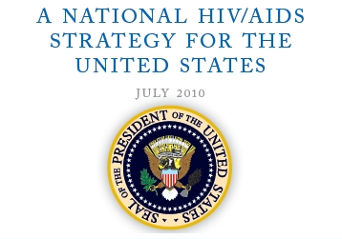
AIDSVu: Supporting the National HIV/AIDS Strategy
Prevent new HIV infections
Improve linkage to prevention, care and treatment
Reduce HIV-related health disparities
Notes:
AIDSVu can play a direct role in supporting the National HIV/AIDS Strategy goals.
AIDSVu images can increase a community’s awareness of the problem and lead directly to more action to prevent new HIV infections.
AIDSVu helps users to take action on the information they’ve learned, such as locating sites to get an HIV test, and finding other prevention, care and treatment resources.
AIDSVu can also be a resource to identify areas and populations most highly affected by HIV, and where HIV prevention resources may be most needed and most impactful.

Slide 7
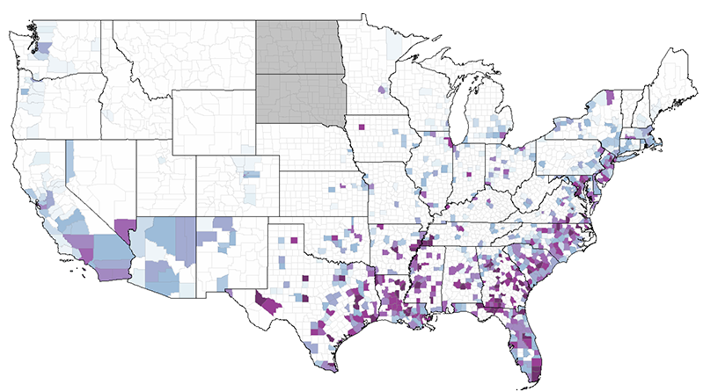
Rates of Persons Newly Diagnosed with HIV, by County, 2013
* Data are not shown to protect privacy. ** State health department requested not to release data.
Note. Data include persons with a diagnosis of HIV infection, regardless of the stage of disease at diagnosis, and have been statistically adjusted to account for reporting delays and missing risk-factor information, but not for incomplete reporting. Data Source: Centers for Disease Control and Prevention, National Center for HIV/AIDS, Viral Hepatitis, STD, and TB Prevention, Division of HIV/AIDS Prevention.
Notes:
Rates of Persons Newly Diagnosed with HIV, by County, 2013
These maps show the estimated county-level rates (per 100,000 population) of adults and adolescents newly diagnosed with HIV at the end of 2013.
Data include adults and adolescents living with a diagnosis of HIV infection, regardless of the stage of disease at diagnosis, and have been statistically adjusted to account for reporting delays and missing risk-factor information, but not for incomplete reporting. All displayed data are estimates based upon actual data reported to CDC through June 2014.
There are no counties in Alaska, the District of Columbia, and Puerto Rico.
Data were released to AIDSVu in accordance with state health departments' HIV surveillance data re-release agreements with CDC.
More information about AIDSVu's data methods and sources can be found at www.aidsvu.org.

Slide 8
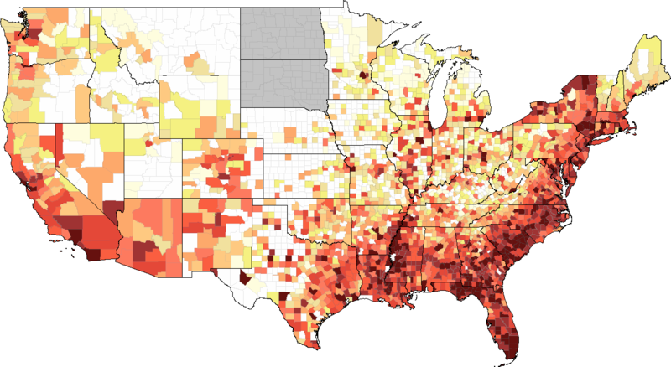
Rates of Persons Living with an HIV Diagnosis, by County, 2012
* Data are not shown to protect privacy. ** State health department requested not to release data.
Note. Data include persons with a diagnosis of HIV infection, regardless of the stage of disease at diagnosis, and have been statistically adjusted to account for reporting delays and missing risk-factor information, but not for incomplete reporting.
Data Source: Centers for Disease Control and Prevention, National Center for HIV/AIDS, Viral Hepatitis, STD, and TB Prevention, Division of HIV/AIDS Prevention.
Notes:
Rates of Persons Living with an HIV Diagnosis, by County, 2012
This map shows the estimated county-level rates (per 100,000 population) of adults and adolescents living with an HIV diagnosis at the end of 2012.
Data include adults and adolescents living with a diagnosis of HIV infection, regardless of the stage of disease at diagnosis, and have been statistically adjusted to account for reporting delays and missing risk-factor information, but not for incomplete reporting. All displayed data are estimates based upon actual data reported to CDC through June 2013.
Persons living with an HIV diagnosis are classified as adult or adolescent based on age at end of 2012.
There are no counties in Alaska, the District of Columbia, and Puerto Rico.
Data were released to AIDSVu in accordance with state health departments' HIV surveillance data re-release agreements with CDC.
More information about AIDSVu's data methods and sources can be found at www.aidsvu.org.

Slide 9
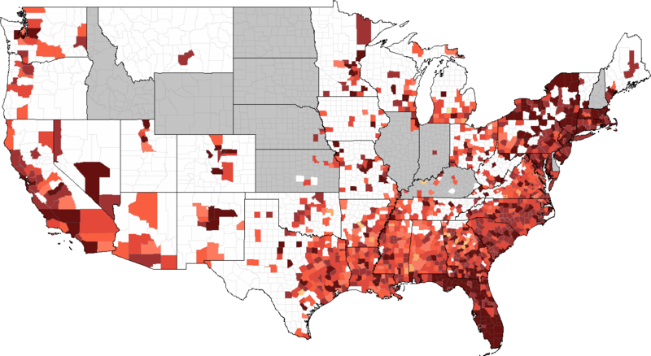
Rates of Black Persons Living with an HIV Diagnosis, by County, 2012
* Data are not shown to protect privacy. ** State health department requested not to release data.
Note. Data include persons with a diagnosis of HIV infection, regardless of the stage of disease at diagnosis, and have been statistically adjusted to account for reporting delays and missing risk-factor information, but not for incomplete reporting.
Data Source: Centers for Disease Control and Prevention, National Center for HIV/AIDS, Viral Hepatitis, STD, and TB Prevention, Division of HIV/AIDS Prevention.
Notes:
Rates of Black Persons Living with an HIV Diagnosis, by County, 2012
This map shows the estimated county-level rates (per 100,000 population) of black adults and adolescents living with an HIV diagnosis at the end of 2012.
Data include adults and adolescents living with a diagnosis of HIV infection, regardless of the stage of disease at diagnosis, and have been statistically adjusted to account for reporting delays and missing risk-factor information, but not for incomplete reporting. All displayed data are estimates based upon actual data reported to CDC through June 2013.
Persons living with an HIV diagnosis are classified as adult or adolescent based on age at end of 2012.
There are no counties in Alaska, the District of Columbia, and Puerto Rico.
Data were released to AIDSVu in accordance with state health departments' HIV surveillance data re-release agreements with CDC.
More information about AIDSVu's data methods and sources can be found at www.aidsvu.org.

Slide 10
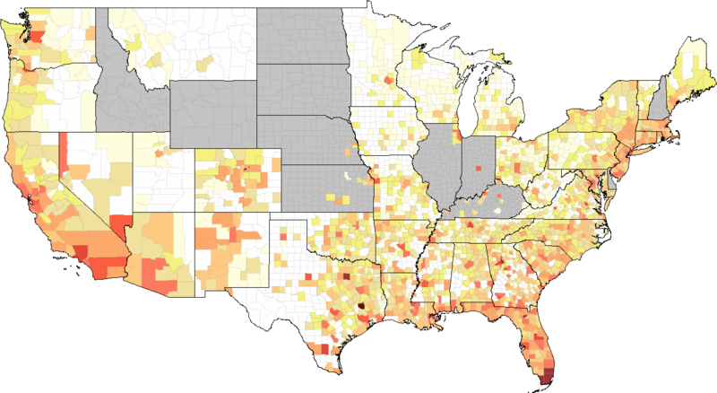
Rates of White Persons Living with an HIV Diagnosis, by County, 2012
* Data are not shown to protect privacy. ** State health department requested not to release data.
Note. Data include persons with a diagnosis of HIV infection, regardless of the stage of disease at diagnosis, and have been statistically adjusted to account for reporting delays and missing risk-factor information, but not for incomplete reporting.
Data Source: Centers for Disease Control and Prevention, National Center for HIV/AIDS, Viral Hepatitis, STD, and TB Prevention, Division of HIV/AIDS Prevention.
Notes:
Rates of White Persons Living with an HIV Diagnosis, by County, 2012
This map shows the estimated county-level rates (per 100,000 population) of white adults and adolescents living with an HIV diagnosis at the end of 2012.
Data include adults and adolescents living with a diagnosis of HIV infection, regardless of the stage of disease at diagnosis, and have been statistically adjusted to account for reporting delays and missing risk-factor information, but not for incomplete reporting. All displayed data are estimates based upon actual data reported to CDC through June 2013.
Persons living with an HIV diagnosis are classified as adult or adolescent based on age at end of 2012.
There are no counties in Alaska, the District of Columbia, and Puerto Rico.
Data were released to AIDSVu in accordance with state health departments' HIV surveillance data re-release agreements with CDC.
More information about AIDSVu's data methods and sources can be found at www.aidsvu.org.

Slide 11
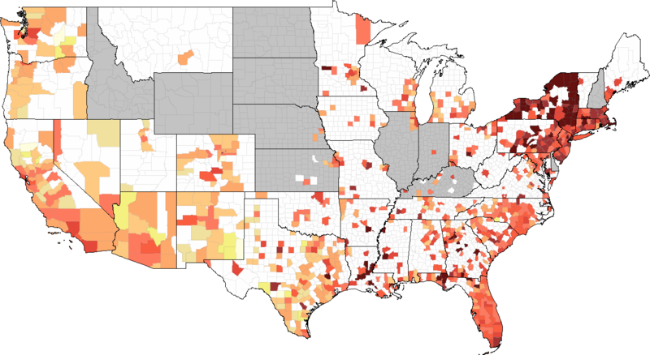
Rates of Hispanic/Latino Persons Living with an HIV Diagnosis, by County, 2012
* Data are not shown to protect privacy. ** State health department requested not to release data.
Note. Data include persons with a diagnosis of HIV infection, regardless of the stage of disease at diagnosis, and have been statistically adjusted to account for reporting delays and missing risk-factor information, but not for incomplete reporting.
Data Source: Centers for Disease Control and Prevention, National Center for HIV/AIDS, Viral Hepatitis, STD, and TB Prevention, Division of HIV/AIDS Prevention.
Notes:
Rates of Hispanic/Latino Persons Living with an HIV Diagnosis, by County, 2012
This map shows the estimated county-level rates (per 100,000 population) of Hispanic/Latino adults and adolescents living with an HIV diagnosis at the end of 2012.
Data include adults and adolescents living with a diagnosis of HIV infection, regardless of the stage of disease at diagnosis, and have been statistically adjusted to account for reporting delays and missing risk-factor information, but not for incomplete reporting. All displayed data are estimates based upon actual data reported to CDC through June 2013.
Persons living with an HIV diagnosis are classified as adult or adolescent based on age at end of 2012.
There are no counties in Alaska, the District of Columbia, and Puerto Rico.
Data were released to AIDSVu in accordance with state health departments' HIV surveillance data re-release agreements with CDC.
More information about AIDSVu's data methods and sources can be found at www.aidsvu.org.

Slide 12
Rates of Black & White Persons Living with an HIV Diagnosis, by County, 2012
Black Rates
White Rates
* Data are not shown to protect privacy. ** State health department requested not to release data.
Note. Data include persons with a diagnosis of HIV infection, regardless of the stage of disease at diagnosis, and have been statistically adjusted to account for reporting delays and missing risk-factor information, but not for incomplete reporting.
Data Source: Centers for Disease Control and Prevention, National Center for HIV/AIDS, Viral Hepatitis, STD, and TB Prevention, Division of HIV/AIDS Prevention.
Notes:
Rates of Black & White Persons Living with an HIV Diagnosis, by County, 2012
These maps show a comparison of the estimated county-level rates (per 100,000 population) of black & white adults and adolescents living with an HIV diagnosis at the end of 2012.
Data include adults and adolescents living with a diagnosis of HIV infection, regardless of the stage of disease at diagnosis, and have been statistically adjusted to account for reporting delays and missing risk-factor information, but not for incomplete reporting. All displayed data are estimates based upon actual data reported to CDC through June 2013.
Persons living with an HIV diagnosis are classified as adult or adolescent based on age at end of 2012.
There are no counties in Alaska, the District of Columbia, and Puerto Rico.
Data were released to AIDSVu in accordance with state health departments' HIV surveillance data re-release agreements with CDC.
More information about AIDSVu's data methods and sources can be found at www.aidsvu.org.

Slide 13
Rates of Hispanic/Latino & White Persons Living with an HIV Diagnosis, by County, 2012
Hispanic/Latino Rates
White Rates
* Data are not shown to protect privacy. ** State health department requested not to release data.
Note. Data include persons with a diagnosis of HIV infection, regardless of the stage of disease at diagnosis, and have been statistically adjusted to account for reporting delays and missing risk-factor information, but not for incomplete reporting.
Data Source: Centers for Disease Control and Prevention, National Center for HIV/AIDS, Viral Hepatitis, STD, and TB Prevention, Division of HIV/AIDS Prevention.
Notes:
Rates of Hispanic/Latino & White Persons Living with an HIV Diagnosis, by County, 2012
These maps show a comparison of the estimated county-level rates (per 100,000 population) of Hispanic/Latino & white adults and adolescents living with an HIV diagnosis at the end of 2012.
Data include adults and adolescents living with a diagnosis of HIV infection, regardless of the stage of disease at diagnosis, and have been statistically adjusted to account for reporting delays and missing risk-factor information, but not for incomplete reporting. All displayed data are estimates based upon actual data reported to CDC through June 2013.
Persons living with an HIV diagnosis are classified as adult or adolescent based on age at end of 2012.
There are no counties in Alaska, the District of Columbia, and Puerto Rico.
Data were released to AIDSVu in accordance with state health departments' HIV surveillance data re-release agreements with CDC.
More information about AIDSVu's data methods and sources can be found at www.aidsvu.org.

Slide 14
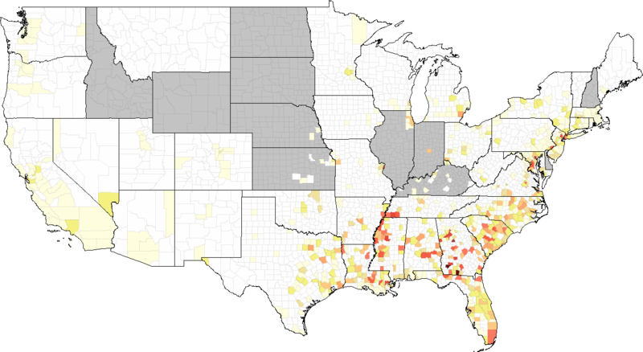
Rates of Persons Aged 13-24 Living with an HIV Diagnosis, by County, 2012
* Data are not shown to protect privacy. ** State health department requested not to release data.
Note. Data include persons with a diagnosis of HIV infection, regardless of the stage of disease at diagnosis, and have been statistically adjusted to account for reporting delays and missing risk-factor information, but not for incomplete reporting.
Data Source: Centers for Disease Control and Prevention, National Center for HIV/AIDS, Viral Hepatitis, STD, and TB Prevention, Division of HIV/AIDS Prevention.
Notes:
Rates of Persons Aged 13-24 Living with an HIV Diagnosis, by County, 2012
This map shows the estimated county-level rates (per 100,000 population) of adults and adolescents aged 13-24 living with an HIV diagnosis at the end of 2012.
Data include adults and adolescents living with a diagnosis of HIV infection, regardless of the stage of disease at diagnosis, and have been statistically adjusted to account for reporting delays and missing risk-factor information, but not for incomplete reporting. All displayed data are estimates based upon actual data reported to CDC through June 2013.
Persons living with an HIV diagnosis are classified as adult or adolescent based on age at end of 2012.
There are no counties in Alaska, the District of Columbia, and Puerto Rico.
Data were released to AIDSVu in accordance with state health departments' HIV surveillance data re-release agreements with CDC.
More information about AIDSVu's data methods and sources can be found at www.aidsvu.org.

Slide 15
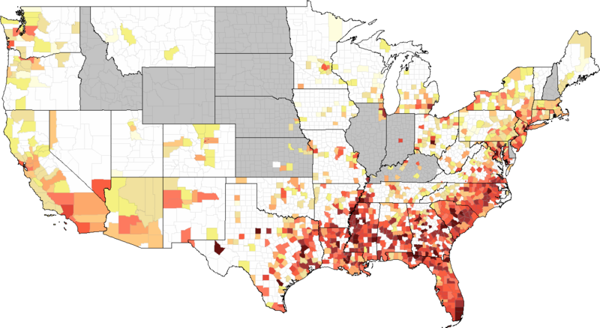
Rates of Persons Aged 25-34 Living with an HIV Diagnosis, by County, 2012
* Data are not shown to protect privacy. ** State health department requested not to release data.
Note. Data include persons with a diagnosis of HIV infection, regardless of the stage of disease at diagnosis, and have been statistically adjusted to account for reporting delays and missing risk-factor information, but not for incomplete reporting.
Data Source: Centers for Disease Control and Prevention, National Center for HIV/AIDS, Viral Hepatitis, STD, and TB Prevention, Division of HIV/AIDS Prevention.
Notes:
Rates of Persons Aged 25-34 Living with an HIV Diagnosis, by County, 2012
This map shows the estimated county-level rates (per 100,000 population) of adults and adolescents aged 25-34 living with an HIV diagnosis at the end of 2012.
Data include adults and adolescents living with a diagnosis of HIV infection, regardless of the stage of disease at diagnosis, and have been statistically adjusted to account for reporting delays and missing risk-factor information, but not for incomplete reporting. All displayed data are estimates based upon actual data reported to CDC through June 2013.
Persons living with an HIV diagnosis are classified as adult or adolescent based on age at end of 2012.
There are no counties in Alaska, the District of Columbia, and Puerto Rico.
Data were released to AIDSVu in accordance with state health departments' HIV surveillance data re-release agreements with CDC.
More information about AIDSVu's data methods and sources can be found at www.aidsvu.org.

Slide 16
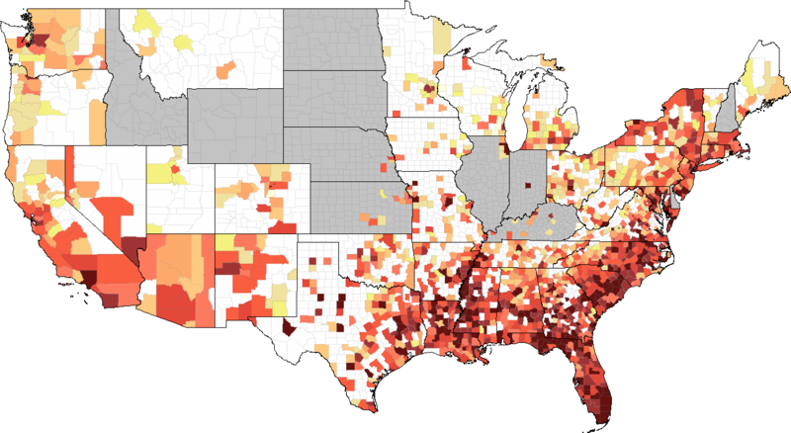
Rates of Persons Aged 35-44 Living with an HIV Diagnosis, by County, 2012
* Data are not shown to protect privacy. ** State health department requested not to release data.
Note. Data include persons with a diagnosis of HIV infection, regardless of the stage of disease at diagnosis, and have been statistically adjusted to account for reporting delays and missing risk-factor information, but not for incomplete reporting.
Data Source: Centers for Disease Control and Prevention, National Center for HIV/AIDS, Viral Hepatitis, STD, and TB Prevention, Division of HIV/AIDS Prevention.
Notes:
Rates of Persons Aged 35-44 Living with an HIV Diagnosis, by County, 2012
This map shows the estimated county-level rates (per 100,000 population) of adults and adolescents aged 35-44 living with an HIV diagnosis at the end of 2012.
Data include adults and adolescents living with a diagnosis of HIV infection, regardless of the stage of disease at diagnosis, and have been statistically adjusted to account for reporting delays and missing risk-factor information, but not for incomplete reporting. All displayed data are estimates based upon actual data reported to CDC through June 2013.
Persons living with an HIV diagnosis are classified as adult or adolescent based on age at end of 2012.
There are no counties in Alaska, the District of Columbia, and Puerto Rico.
Data were released to AIDSVu in accordance with state health departments' HIV surveillance data re-release agreements with CDC.
More information about AIDSVu's data methods and sources can be found at www.aidsvu.org.

Slide 17
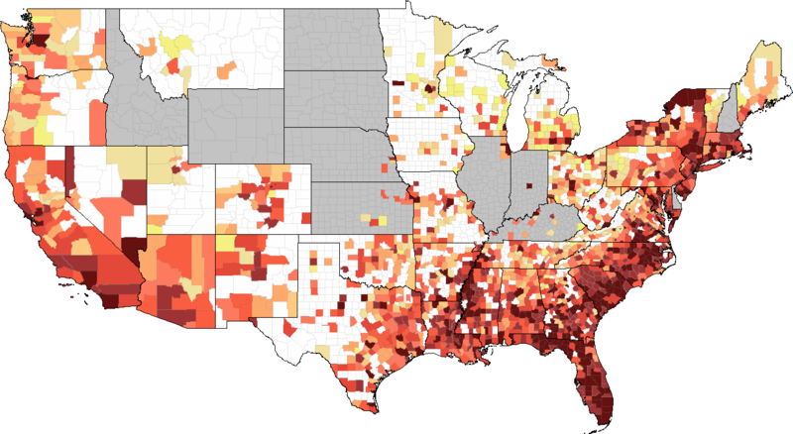
Rates of Persons Aged 45-54 Living with an HIV Diagnosis, by County, 2012
* Data are not shown to protect privacy. ** State health department requested not to release data.
Note. Data include persons with a diagnosis of HIV infection, regardless of the stage of disease at diagnosis, and have been statistically adjusted to account for reporting delays and missing risk-factor information, but not for incomplete reporting.
Data Source: Centers for Disease Control and Prevention, National Center for HIV/AIDS, Viral Hepatitis, STD, and TB Prevention, Division of HIV/AIDS Prevention.
Notes:
Rates of Persons Aged 45-54 Living with an HIV Diagnosis, by County, 2012
This map shows the estimated county-level rates (per 100,000 population) of adults and adolescents aged 45-54 living with an HIV diagnosis at the end of 2012.
Data include adults and adolescents living with a diagnosis of HIV infection, regardless of the stage of disease at diagnosis, and have been statistically adjusted to account for reporting delays and missing risk-factor information, but not for incomplete reporting. All displayed data are estimates based upon actual data reported to CDC through June 2013.
Persons living with an HIV diagnosis are classified as adult or adolescent based on age at end of 2012.
There are no counties in Alaska, the District of Columbia, and Puerto Rico.
Data were released to AIDSVu in accordance with state health departments' HIV surveillance data re-release agreements with CDC.
More information about AIDSVu's data methods and sources can be found at www.aidsvu.org.

Slide 18
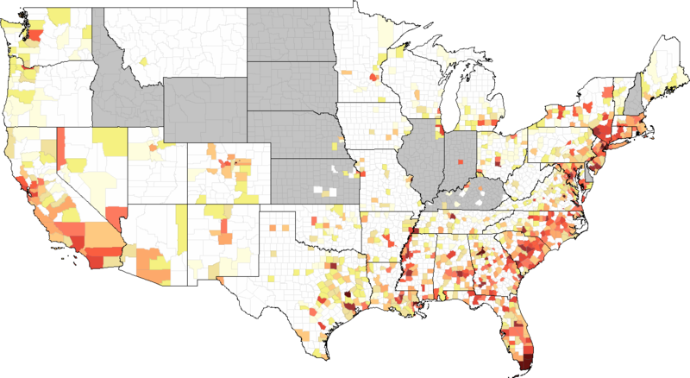
Rates of Persons Aged 55 & Older Living with an HIV Diagnosis, by County, 2012
* Data are not shown to protect privacy. ** State health department requested not to release data.
Note. Data include persons with a diagnosis of HIV infection, regardless of the stage of disease at diagnosis, and have been statistically adjusted to account for reporting delays and missing risk-factor information, but not for incomplete reporting.
Data Source: Centers for Disease Control and Prevention, National Center for HIV/AIDS, Viral Hepatitis, STD, and TB Prevention, Division of HIV/AIDS Prevention.
Notes:
Rates of Persons Aged 55 & Older Living with an HIV Diagnosis, by County, 2012
This map shows the estimated county-level rates (per 100,000 population) of adults and adolescents aged 55 & older living with an HIV diagnosis at the end of 2012.
Data include adults and adolescents living with a diagnosis of HIV infection, regardless of the stage of disease at diagnosis, and have been statistically adjusted to account for reporting delays and missing risk-factor information, but not for incomplete reporting. All displayed data are estimates based upon actual data reported to CDC through June 2013.
Persons living with an HIV diagnosis are classified as adult or adolescent based on age at end of 2012.
There are no counties in Alaska, the District of Columbia, and Puerto Rico.
Data were released to AIDSVu in accordance with state health departments' HIV surveillance data re-release agreements with CDC.
More information about AIDSVu's data methods and sources can be found at www.aidsvu.org.

Slide 19
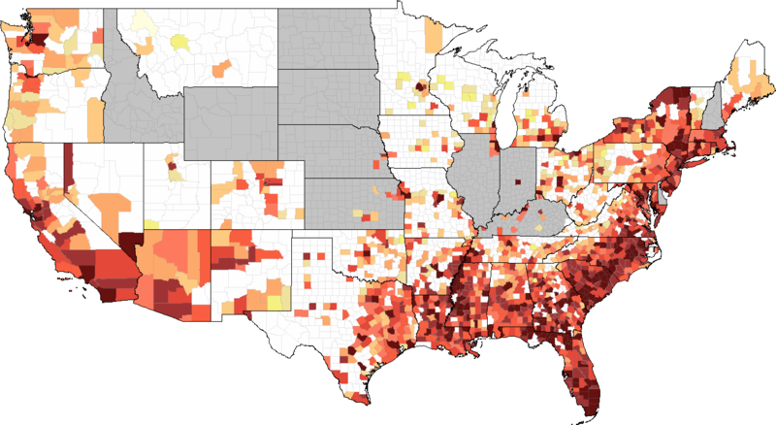
Rates of Males Living with an HIV Diagnosis, by County, 2012
* Data are not shown to protect privacy. ** State health department requested not to release data.
Note. Data include persons with a diagnosis of HIV infection, regardless of the stage of disease at diagnosis, and have been statistically adjusted to account for reporting delays and missing risk-factor information, but not for incomplete reporting.
Data Source: Centers for Disease Control and Prevention, National Center for HIV/AIDS, Viral Hepatitis, STD, and TB Prevention, Division of HIV/AIDS Prevention.
Notes:
Rates of Males Living with an HIV Diagnosis, by County, 2012
This map shows the estimated county-level rates (per 100,000 population) of male adults and adolescents living with an HIV diagnosis at the end of 2012.
Data include adults and adolescents living with a diagnosis of HIV infection, regardless of the stage of disease at diagnosis, and have been statistically adjusted to account for reporting delays and missing risk-factor information, but not for incomplete reporting. All displayed data are estimates based upon actual data reported to CDC through June 2013.
Persons living with an HIV diagnosis are classified as adult or adolescent based on age at end of 2012.
There are no counties in Alaska, the District of Columbia, and Puerto Rico.
Data were released to AIDSVu in accordance with state health departments' HIV surveillance data re-release agreements with CDC.
More information about AIDSVu's data methods and sources can be found at www.aidsvu.org.

Slide 20
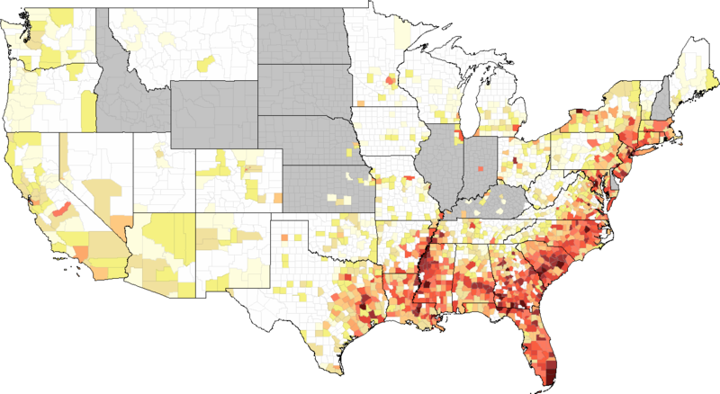
Rates of Females Living with an HIV Diagnosis, by County, 2012
* Data are not shown to protect privacy. ** State health department requested not to release data.
Note. Data include persons with a diagnosis of HIV infection, regardless of the stage of disease at diagnosis, and have been statistically adjusted to account for reporting delays and missing risk-factor information, but not for incomplete reporting.
Data Source: Centers for Disease Control and Prevention, National Center for HIV/AIDS, Viral Hepatitis, STD, and TB Prevention, Division of HIV/AIDS Prevention.
Notes:
Rates of Females Living with an HIV Diagnosis, by County, 2012
This map shows the estimated county-level rates (per 100,000 population) of female adults and adolescents living with an HIV diagnosis at the end of 2012.
Data include adults and adolescents living with a diagnosis of HIV infection, regardless of the stage of disease at diagnosis, and have been statistically adjusted to account for reporting delays and missing risk-factor information, but not for incomplete reporting. All displayed data are estimates based upon actual data reported to CDC through June 2013.
Persons living with an HIV diagnosis are classified as adult or adolescent based on age at end of 2012. Sex is defined as sex at birth.
There are no counties in Alaska, the District of Columbia, and Puerto Rico.
Data were released to AIDSVu in accordance with state health departments' HIV surveillance data re-release agreements with CDC.
More information about AIDSVu's data methods and sources can be found at www.aidsvu.org.

Slide 21
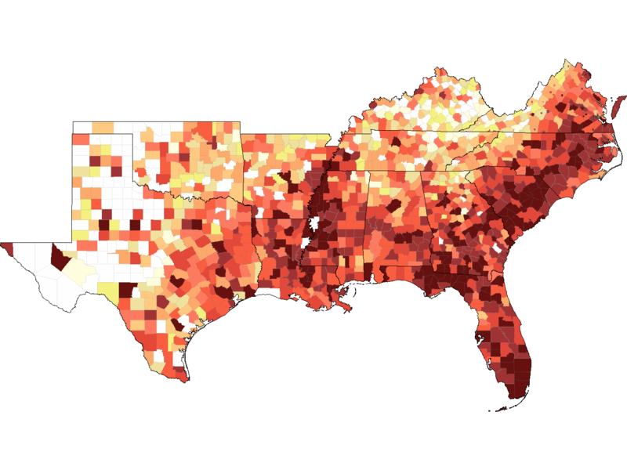
Rates of Persons Living with an HIV Diagnosis by County, Southeastern U.S., 2012
* Data are not shown to protect privacy. ** State health department requested not to release data.
Note. Data include persons with a diagnosis of HIV infection, regardless of the stage of disease at diagnosis, and have been statistically adjusted to account for reporting delays and missing risk-factor information, but not for incomplete reporting.
Data Source: Centers for Disease Control and Prevention, National Center for HIV/AIDS, Viral Hepatitis, STD, and TB Prevention, Division of HIV/AIDS Prevention.
Notes:
Rates of Persons Living with an HIV Diagnosis, by County, Southeastern U.S., 2012. By definition, the Southeast includes Texas, Oklahoma, Arizona, Louisiana, Mississippi, Alabama, Tennessee, Kentucky, Virginia, North Carolina, South Carolina, Georgia, and Florida.
This map shows the estimated county-level rates (per 100,000 population) of adults and adolescents living with an HIV diagnosis in the southeastern U.S. at the end of 2012.
Data include adults and adolescents living with a diagnosis of HIV infection, regardless of the stage of disease at diagnosis, and have been statistically adjusted to account for reporting delays and missing risk-factor information, but not for incomplete reporting. All displayed data are estimates based upon actual data reported to CDC through June 2013.
Persons living with an HIV diagnosis are classified as adult or adolescent based on age at end of 2012. Sex is defined as sex at birth.
There are no counties in Alaska, the District of Columbia, and Puerto Rico.
Data were released to AIDSVu in accordance with state health departments' HIV surveillance data re-release agreements with CDC.
More information about AIDSVu's data methods and sources can be found at www.aidsvu.org

Slide 22
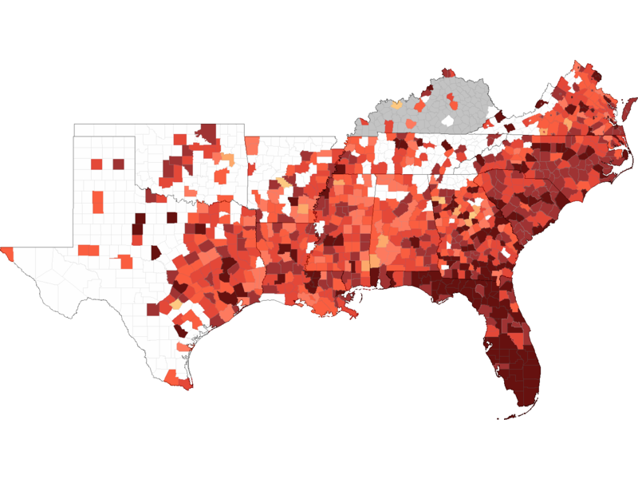
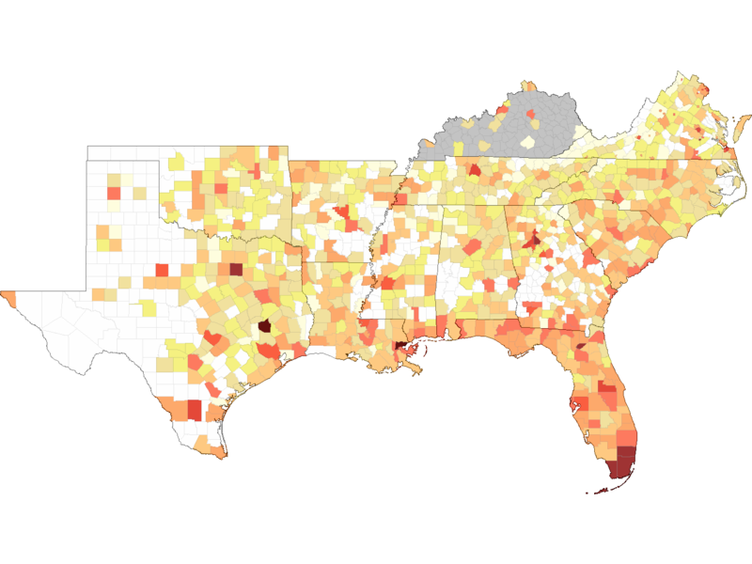
Rates of Black & White Persons Living with an HIV Diagnosis, by County, Southeastern U.S., 2012
Black Rates
White Rates
* Data are not shown to protect privacy. ** State health department requested not to release data.
Note. Data include persons with a diagnosis of HIV infection, regardless of the stage of disease at diagnosis, and have been statistically adjusted to account for reporting delays and missing risk-factor information, but not for incomplete reporting.
Data Source: Centers for Disease Control and Prevention, National Center for HIV/AIDS, Viral Hepatitis, STD, and TB Prevention, Division of HIV/AIDS Prevention.
Notes:
Rates of Black & White Persons Living with an HIV Diagnosis, by County, Southeastern U.S., 2012. By definition, the Southeast includes Texas, Oklahoma, Arizona, Louisiana, Mississippi, Alabama, Tennessee, Kentucky, Virginia, North Carolina, South Carolina, Georgia, and Florida.
These maps show a comparison of the estimated county-level rates (per 100,000 population) of black & white adults and adolescents living with an HIV diagnosis in the southeastern U.S. at the end of 2012.
Data include adults and adolescents living with a diagnosis of HIV infection, regardless of the stage of disease at diagnosis, and have been statistically adjusted to account for reporting delays and missing risk-factor information, but not for incomplete reporting. All displayed data are estimates based upon actual data reported to CDC through June 2013.
Persons living with an HIV diagnosis are classified as adult or adolescent based on age at end of 2012.
There are no counties in Alaska, the District of Columbia, and Puerto Rico.
Data were released to AIDSVu in accordance with state health departments' HIV surveillance data re-release agreements with CDC.
More information about AIDSVu's data methods and sources can be found at www.aidsvu.org

Slide 23
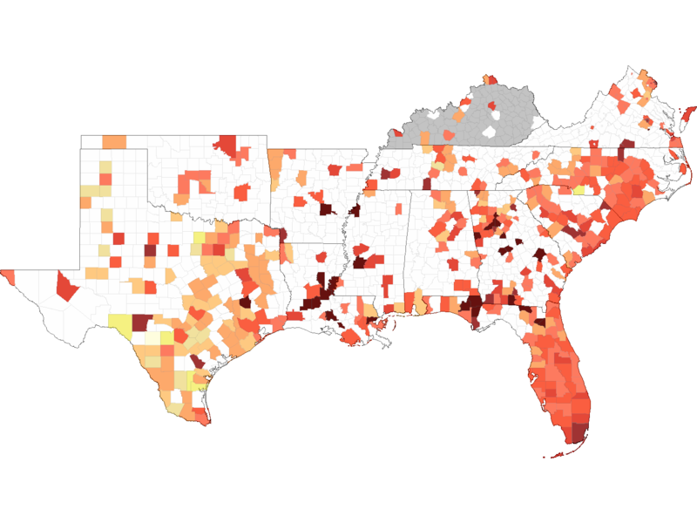
Rates of Hispanic/Latino & White Persons Living with an HIV Diagnosis, by County, Southeastern U.S., 2012
Hispanic/Latino Rates
White Rates
* Data are not shown to protect privacy. ** State health department requested not to release data.
Note. Data include persons with a diagnosis of HIV infection, regardless of the stage of disease at diagnosis, and have been statistically adjusted to account for reporting delays and missing risk-factor information, but not for incomplete reporting.
Data Source: Centers for Disease Control and Prevention, National Center for HIV/AIDS, Viral Hepatitis, STD, and TB Prevention, Division of HIV/AIDS Prevention.
Notes:
Rates of Hispanic/Latino & White Persons Living with an HIV Diagnosis, by County, Southeastern U.S., 2012. By definition, the Southeast includes Texas, Oklahoma, Arizona, Louisiana, Mississippi, Alabama, Tennessee, Kentucky, Virginia, North Carolina, South Carolina, Georgia, and Florida.
These maps shows a comparison of the estimated county-level rates (per 100,000 population) of Hispanic/Latino & white adults and adolescents living with an HIV diagnosis in the southeastern U.S. at the end of 2012.
Data include adults and adolescents living with a diagnosis of HIV infection, regardless of the stage of disease at diagnosis, and have been statistically adjusted to account for reporting delays and missing risk-factor information, but not for incomplete reporting. All displayed data are estimates based upon actual data reported to CDC through June 2013.
Persons living with an HIV diagnosis are classified as adult or adolescent based on age at end of 2012.
There are no counties in Alaska, the District of Columbia, and Puerto Rico.
Data were released to AIDSVu in accordance with state health departments' HIV surveillance data re-release agreements with CDC.
More information about AIDSVu's data methods and sources can be found at www.aidsvu.org

Slide 24
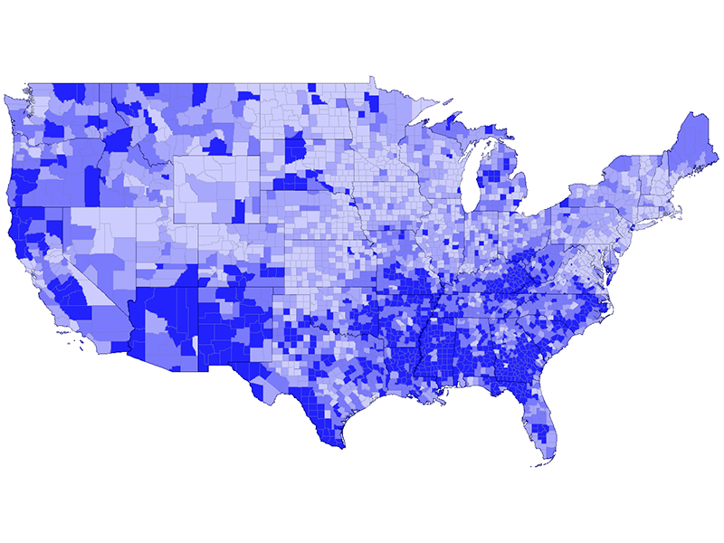
Rates of Persons Living with an HIV Diagnosis & Poverty Rates, by County, 2012
Persons Living with an HIV Diagnosis
Poverty Rates
* Data are not shown to protect privacy. ** State health department requested not to release data.
Note. Data include persons with a diagnosis of HIV infection, regardless of the stage of disease at diagnosis, and have been statistically adjusted to account for reporting delays and missing risk-factor information, but not for incomplete reporting.
Data Source: Centers for Disease Control and Prevention, National Center for HIV/AIDS, Viral Hepatitis, STD, and TB Prevention, Division of HIV/AIDS Prevention.
Notes:
Rates of Persons Living with an HIV Diagnosis & Poverty Rates, by County, 2012
These maps show the estimated county-level rates (per 100,000 population) of adults and adolescents living with an HIV diagnosis at the end of 2012 on the left and the percent of the county population living in poverty on the right.
Data include adults and adolescents living with a diagnosis of HIV infection, regardless of the stage of disease at diagnosis, and have been statistically adjusted to account for reporting delays and missing risk-factor information, but not for incomplete reporting. All displayed data are estimates based upon actual data reported to CDC through June 2013.
Persons living with an HIV diagnosis are classified as adult or adolescent based on age at end of 2012.
There are no counties in Alaska, the District of Columbia, and Puerto Rico.
Data were released to AIDSVu in accordance with state health departments' HIV surveillance data re-release agreements with CDC.
More information about AIDSVu's data methods and sources can be found at www.aidsvu.org

Slide 25
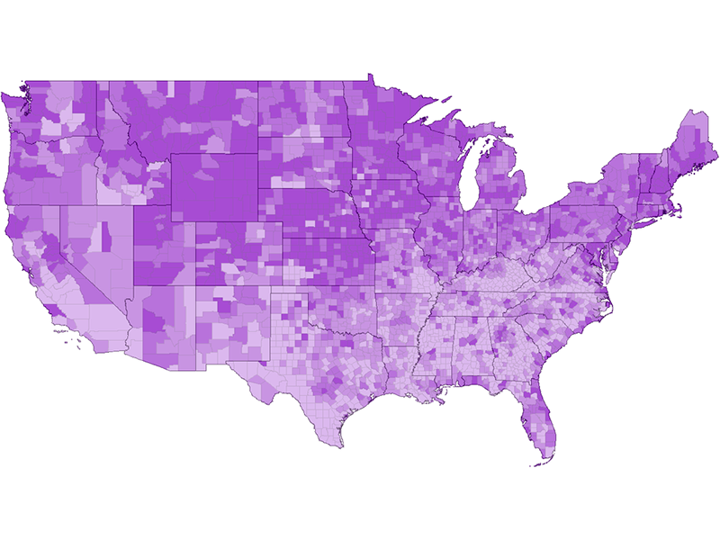
Rates of Persons Living with an HIV Diagnosis & Percent with High School Education, by County, 2012
Persons Living with an HIV Diagnosis
Percent with High School Education
* Data are not shown to protect privacy. ** State health department requested not to release data.
Note. Data include persons with a diagnosis of HIV infection, regardless of the stage of disease at diagnosis, and have been statistically adjusted to account for reporting delays and missing risk-factor information, but not for incomplete reporting.
Data Source: Centers for Disease Control and Prevention, National Center for HIV/AIDS, Viral Hepatitis, STD, and TB Prevention, Division of HIV/AIDS Prevention.
Notes:
Rates of Persons Living with an HIV Diagnosis & Percent with High School Education, by County, 2012
These maps show the estimated county-level rates (per 100,000 population) of adults and adolescents living with an HIV diagnosis at the end of 2012 on the left and the percent of the county population with a high school education on the right.
Data include adults and adolescents living with a diagnosis of HIV infection, regardless of the stage of disease at diagnosis, and have been statistically adjusted to account for reporting delays and missing risk-factor information, but not for incomplete reporting. All displayed data are estimates based upon actual data reported to CDC through June 2013.
Persons living with an HIV diagnosis are classified as adult or adolescent based on age at end of 2012.
There are no counties in Alaska, the District of Columbia, and Puerto Rico.
Data were released to AIDSVu in accordance with state health departments' HIV surveillance data re-release agreements with CDC.
More information about AIDSVu's data methods and sources can be found at www.aidsvu.org

Slide 26
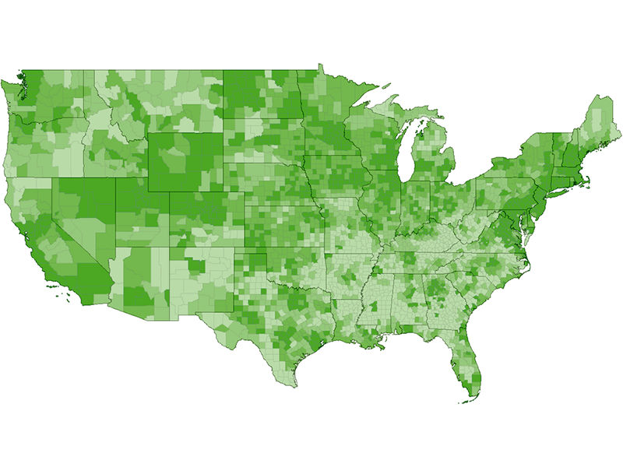
Rates of Persons Living with an HIV Diagnosis & Median Household Income, by County, 2012
Persons Living with an HIV Diagnosis
Median Household Income
* Data are not shown to protect privacy. ** State health department requested not to release data.
Note. Data include persons with a diagnosis of HIV infection, regardless of the stage of disease at diagnosis, and have been statistically adjusted to account for reporting delays and missing risk-factor information, but not for incomplete reporting.
Data Source: Centers for Disease Control and Prevention, National Center for HIV/AIDS, Viral Hepatitis, STD, and TB Prevention, Division of HIV/AIDS Prevention.
Notes:
Rates of Persons Living with an HIV Diagnosis & Median Household Income, by County, 2012
These maps show the estimated county-level rates (per 100,000 population) of adults and adolescents living with an HIV diagnosis at the end of 2012 on the left and the median household income at the county level on the right.
Data include adults and adolescents living with a diagnosis of HIV infection, regardless of the stage of disease at diagnosis, and have been statistically adjusted to account for reporting delays and missing risk-factor information, but not for incomplete reporting. All displayed data are estimates based upon actual data reported to CDC through June 2013.
Persons living with an HIV diagnosis are classified as adult or adolescent based on age at end of 2012.
There are no counties in Alaska, the District of Columbia, and Puerto Rico.
Data were released to AIDSVu in accordance with state health departments' HIV surveillance data re-release agreements with CDC.
More information about AIDSVu's data methods and sources can be found at www.aidsvu.org

Slide 27
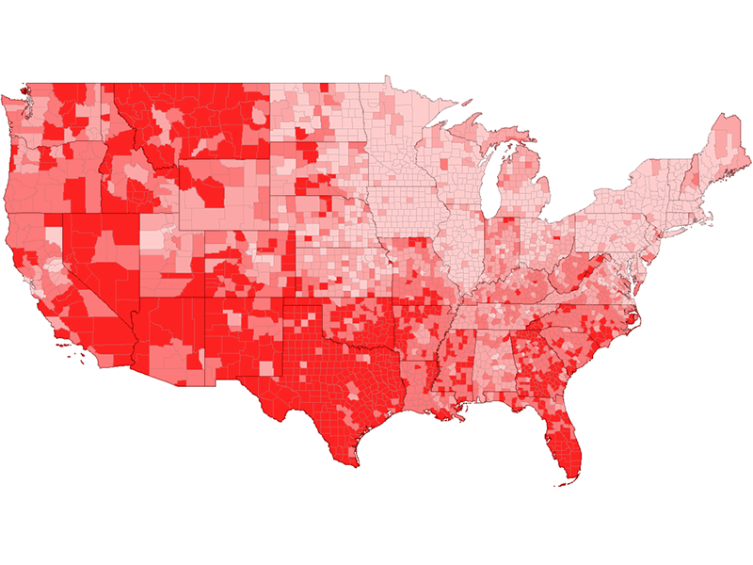
Rates of Persons Living with an HIV Diagnosis & Percent of Population without Health Insurance, by County, 2012
Persons Living with an HIV Diagnosis
Population without Health Insurance
* Data are not shown to protect privacy. ** State health department requested not to release data.
Note. Data include persons with a diagnosis of HIV infection, regardless of the stage of disease at diagnosis, and have been statistically adjusted to account for reporting delays and missing risk-factor information, but not for incomplete reporting.
Data Source: Centers for Disease Control and Prevention, National Center for HIV/AIDS, Viral Hepatitis, STD, and TB Prevention, Division of HIV/AIDS Prevention.
Notes:
Rates of Persons Living with an HIV Diagnosis & Percent of Population without Health Insurance, by County, 2012
These maps show the estimated county-level rates (per 100,000 population) of adults and adolescents living with an HIV diagnosis at the end of 2012 on the left and the percent of the county population without health insurance on the right.
Data include adults and adolescents living with a diagnosis of HIV infection, regardless of the stage of disease at diagnosis, and have been statistically adjusted to account for reporting delays and missing risk-factor information, but not for incomplete reporting. All displayed data are estimates based upon actual data reported to CDC through June 2013.
Persons living with an HIV diagnosis are classified as adult or adolescent based on age at end of 2012.
There are no counties in Alaska, the District of Columbia, and Puerto Rico.
Data were released to AIDSVu in accordance with state health departments' HIV surveillance data re-release agreements with CDC.
More information about AIDSVu's data methods and sources can be found at www.aidsvu.org

Slide 28
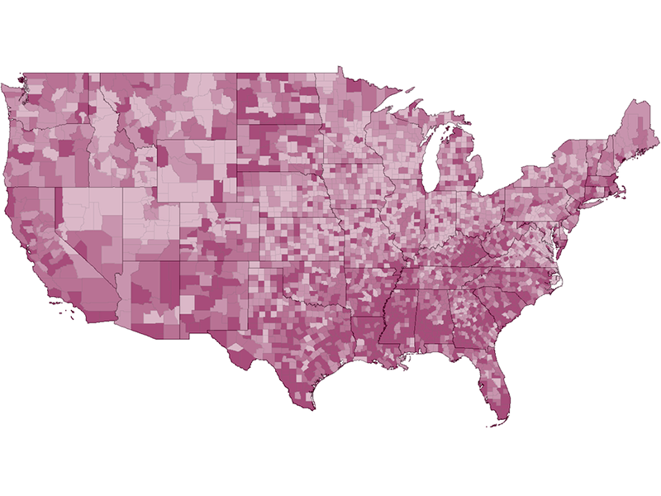
Rates of Persons Living with an HIV Diagnosis & Income Inequality (Gini Coefficient), by County, 2012
Persons Living with an HIV Diagnosis
Income Inequality
* Data are not shown to protect privacy. ** State health department requested not to release data.
Note. Data include persons with a diagnosis of HIV infection, regardless of the stage of disease at diagnosis, and have been statistically adjusted to account for reporting delays and missing risk-factor information, but not for incomplete reporting.
Data Source: Centers for Disease Control and Prevention, National Center for HIV/AIDS, Viral Hepatitis, STD, and TB Prevention, Division of HIV/AIDS Prevention.
Notes:
Rates of Persons Living with an HIV Diagnosis & Income Inequality (Gini Coefficient), by County, 2012
These maps show the estimated county-level rates (per 100,000 population) of adults and adolescents living with an HIV diagnosis at the end of 2012 on the left and county-level measures of income inequality (Gini coefficient) on the right.
Data include adults and adolescents living with a diagnosis of HIV infection, regardless of the stage of disease at diagnosis, and have been statistically adjusted to account for reporting delays and missing risk-factor information, but not for incomplete reporting. All displayed data are estimates based upon actual data reported to CDC through June 2013.
Persons living with an HIV diagnosis are classified as adult or adolescent based on age at end of 2012.
There are no counties in Alaska, the District of Columbia, and Puerto Rico.
Data were released to AIDSVu in accordance with state health departments' HIV surveillance data re-release agreements with CDC.
More information about AIDSVu's data methods and sources can be found at www.aidsvu.org

Slide 29
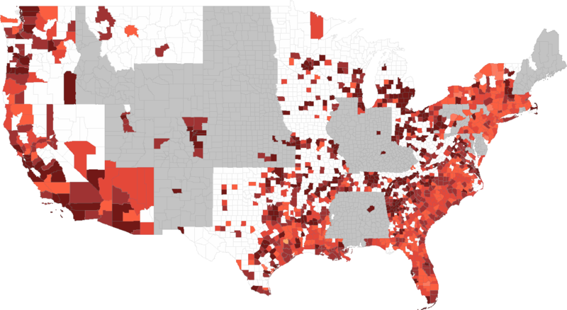
Percent of Males Living with an HIV Diagnosis for whom Infection is Attributed to Male-to-Male Sexual Contact, by County, 2012
* Data are not shown to protect privacy. ** State health department requested not to release data.
Note. Data include persons with a diagnosis of HIV infection, regardless of the stage of disease at diagnosis, and have been statistically adjusted to account for reporting delays and missing risk-factor information, but not for incomplete reporting.
Data Source: Centers for Disease Control and Prevention, National Center for HIV/AIDS, Viral Hepatitis, STD, and TB Prevention, Division of HIV/AIDS Prevention.
Notes:
Percent of Males Living with an HIV Diagnosis for whom Infection is Attributed to Male-to-Male Sexual Contact, by County, 2012
This map shows the state-level percent of all male adults and adolescents living with an HIV diagnosis at the end of 2012 for whom infection is attributed to male-to-male sexual contact.
Data include adults and adolescents living with a diagnosis of HIV infection, regardless of the stage of disease at diagnosis, and have been statistically adjusted to account for reporting delays and missing risk-factor information, but not for incomplete reporting. All displayed data are estimates based upon actual data reported to CDC through June 2013.
Persons living with an HIV diagnosis are classified as adult or adolescent based on age at end of 2012. Sex is defined as sex at birth.
There are no counties in Alaska, the District of Columbia, and Puerto Rico.
Data were released to AIDSVu in accordance with state health departments' HIV surveillance data re-release agreements with CDC.
More information about AIDSVu's data methods and sources can be found at www.aidsvu.org

Slide 30
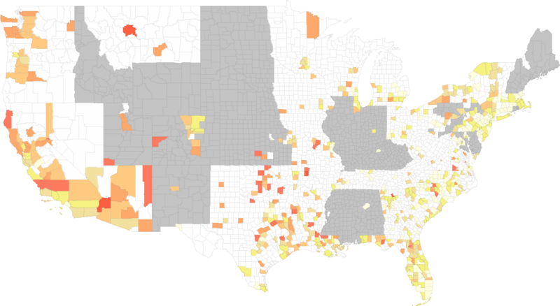
Percent of Males Living with an HIV Diagnosis for whom Infection is Attributed to Male-to-Male Sexual Contact & Injection Drug Use, by County, 2012
* Data are not shown to protect privacy. ** State health department requested not to release data.
Note. Data include persons with a diagnosis of HIV infection, regardless of the stage of disease at diagnosis, and have been statistically adjusted to account for reporting delays and missing risk-factor information, but not for incomplete reporting. Data Source: Centers for Disease Control and Prevention, National Center for HIV/AIDS, Viral Hepatitis, STD, and TB Prevention, Division of HIV/AIDS Prevention.
Notes:
Percent of Males Living with an HIV Diagnosis for whom Infection is Attributed to Male-to-Male Sexual Contact & Injection Drug Use, by County, 2012
This map shows the state-level percent of all male adults and adolescents living with an HIV diagnosis at the end of 2012 for whom infection is attributed to male-to-male sexual contact and injection drug use.
Data include adults and adolescents living with a diagnosis of HIV infection, regardless of the stage of disease at diagnosis, and have been statistically adjusted to account for reporting delays and missing risk-factor information, but not for incomplete reporting. All displayed data are estimates based upon actual data reported to CDC through June 2013.
Persons living with an HIV diagnosis are classified as adult or adolescent based on age at end of 2012. Sex is defined as sex at birth.
There are no counties in Alaska, the District of Columbia, and Puerto Rico.
Data were released to AIDSVu in accordance with state health departments' HIV surveillance data re-release agreements with CDC.
More information about AIDSVu's data methods and sources can be found at www.aidsvu.org

Slide 31
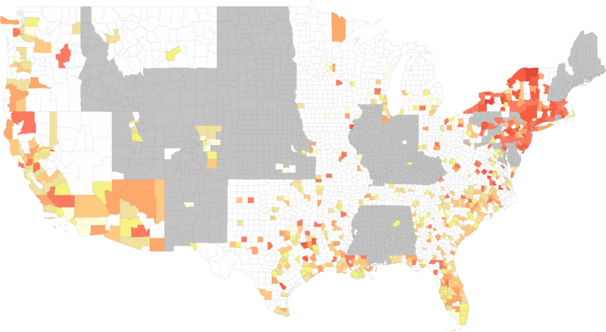
Percent of Males Living with an HIV Diagnosis for whom Infection is Attributed to Injection Drug Use, by County, 2012
* Data are not shown to protect privacy. ** State health department requested not to release data.
Note. Data include persons with a diagnosis of HIV infection, regardless of the stage of disease at diagnosis, and have been statistically adjusted to account for reporting delays and missing risk-factor information, but not for incomplete reporting. Data Source: Centers for Disease Control and Prevention, National Center for HIV/AIDS, Viral Hepatitis, STD, and TB Prevention, Division of HIV/AIDS Prevention.
Notes:
Percent of Males Living with an HIV Diagnosis for whom Infection is Attributed to Injection Drug Use, by County, 2012
This map shows the state-level percent of all male adults and adolescents living with an HIV diagnosis at the end of 2012 for whom infection is attributed to injection drug use.
Persons living with an HIV diagnosis are classified as adult or adolescent based on age at end of 2012. Sex is defined as sex at birth.
There are no counties in Alaska, the District of Columbia, and Puerto Rico.
Data were released to AIDSVu in accordance with state health departments' HIV surveillance data re-release agreements with CDC.
More information about AIDSVu's data methods and sources can be found at www.aidsvu.org

Slide 32
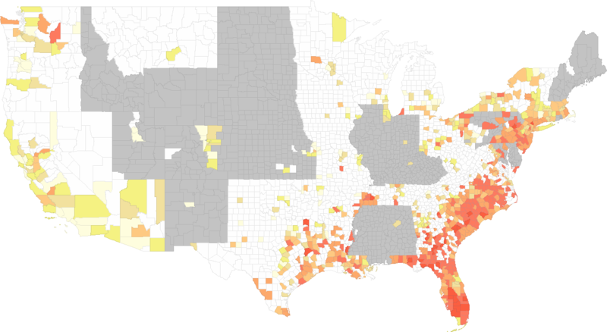
Percent of Males Living with an HIV Diagnosis for whom Infection is Attributed to Heterosexual Contact, by State, 2012
* Data are not shown to protect privacy. ** State health department requested not to release data.
Note. Data include persons with a diagnosis of HIV infection, regardless of the stage of disease at diagnosis, and have been statistically adjusted to account for reporting delays and missing risk-factor information, but not for incomplete reporting. Data Source: Centers for Disease Control and Prevention, National Center for HIV/AIDS, Viral Hepatitis, STD, and TB Prevention, Division of HIV/AIDS Prevention.
Notes:
Percent of Males Living with an HIV Diagnosis for whom Infection is Attributed to Heterosexual Contact, by County, 2012
This map shows the state-level percent of all male adults and adolescents living with an HIV diagnosis at the end of 2012 for whom infection is attributed to heterosexual contact. With respect to mode of transmission, heterosexual contact is defined as heterosexual contact with a person known to have, or to be at high risk for, HIV infection.
Data include adults and adolescents living with a diagnosis of HIV infection, regardless of the stage of disease at diagnosis, and have been statistically adjusted to account for reporting delays and missing risk-factor information, but not for incomplete reporting. All displayed data are estimates based upon actual data reported to CDC through June 2013.
Persons living with an HIV diagnosis are classified as adult or adolescent based on age at end of 2012. Sex is defined as sex at birth.
There are no counties in Alaska, the District of Columbia, and Puerto Rico.
Data were released to AIDSVu in accordance with state health departments' HIV surveillance data re-release agreements with CDC.
More information about AIDSVu's data methods and sources can be found at www.aidsvu.org

Slide 33
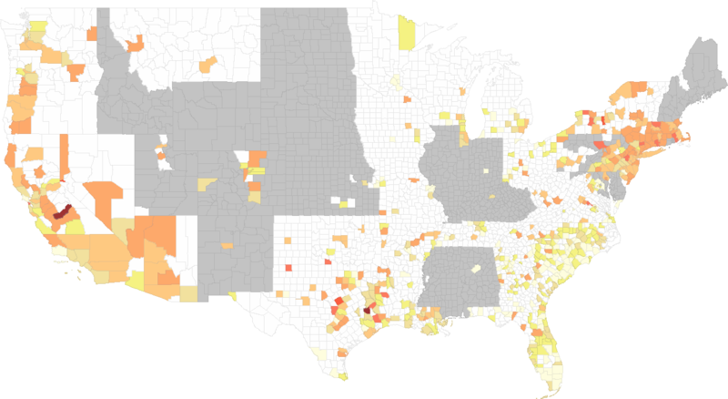
Percent of Females Living with an HIV Diagnosis for whom Infection is Attributed to Injection Drug Use, by County, 2012
* Data are not shown to protect privacy. ** State health department requested not to release data.
Note. Data include persons with a diagnosis of HIV infection, regardless of the stage of disease at diagnosis, and have been statistically adjusted to account for reporting delays and missing risk-factor information, but not for incomplete reporting. Data Source: Centers for Disease Control and Prevention, National Center for HIV/AIDS, Viral Hepatitis, STD, and TB Prevention, Division of HIV/AIDS Prevention.
Notes:
Percent of Females Living with an HIV Diagnosis for whom Infection is Attributed to Injection Drug Use, by County, 2012
This map shows the County-level percent of all female adults and adolescents living with an HIV diagnosis at the end of 2012 for whom infection is attributed to injection drug use.
Data include adults and adolescents living with a diagnosis of HIV infection, regardless of the stage of disease at diagnosis, and have been statistically adjusted to account for reporting delays and missing risk-factor information, but not for incomplete reporting. All displayed data are estimates based upon actual data reported to CDC through June 2013.
Persons living with an HIV diagnosis are classified as adult or adolescent based on age at end of 2012. Sex is defined as sex at birth.
There are no counties in Alaska, the District of Columbia, and Puerto Rico.
Data were released to AIDSVu in accordance with state health departments' HIV surveillance data re-release agreements with CDC.
More information about AIDSVu's data methods and sources can be found at www.aidsvu.org

Slide 34
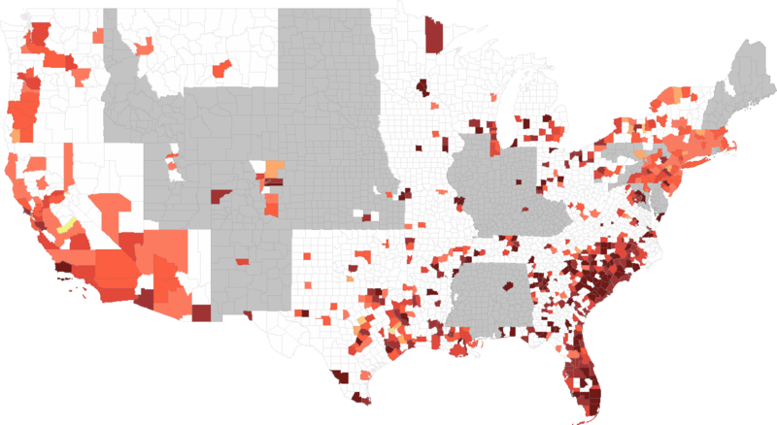
Percent of Females Living with an HIV Diagnosis for whom Infection is Attributed to Heterosexual Contact, by County, 2012
* Data are not shown to protect privacy. ** State health department requested not to release data.
Note. Data include persons with a diagnosis of HIV infection, regardless of the stage of disease at diagnosis, and have been statistically adjusted to account for reporting delays and missing risk-factor information, but not for incomplete reporting. Data Source: Centers for Disease Control and Prevention, National Center for HIV/AIDS, Viral Hepatitis, STD, and TB Prevention, Division of HIV/AIDS Prevention.
Notes:
Percent of Females Living with an HIV Diagnosis for whom Infection is Attributed to Heterosexual Contact, by County, 2012
This map shows the County-level percent of all female adults and adolescents living with an HIV diagnosis at the end of 2012 for whom infection is attributed to heterosexual contact. With respect to mode of transmission, heterosexual contact is defined as heterosexual contact with a person known to have, or to be at high risk for, HIV infection.
Data include adults and adolescents living with a diagnosis of HIV infection, regardless of the stage of disease at diagnosis, and have been statistically adjusted to account for reporting delays and missing risk-factor information, but not for incomplete reporting. All displayed data are estimates based upon actual data reported to CDC through June 2013.
Persons living with an HIV diagnosis are classified as adult or adolescent based on age at end of 2012. Sex is defined as sex at birth.
There are no counties in Alaska, the District of Columbia, and Puerto Rico.
Data were released to AIDSVu in accordance with state health departments' HIV surveillance data re-release agreements with CDC.
More information about AIDSVu's data methods and sources can be found at www.aidsvu.org

Slide 35
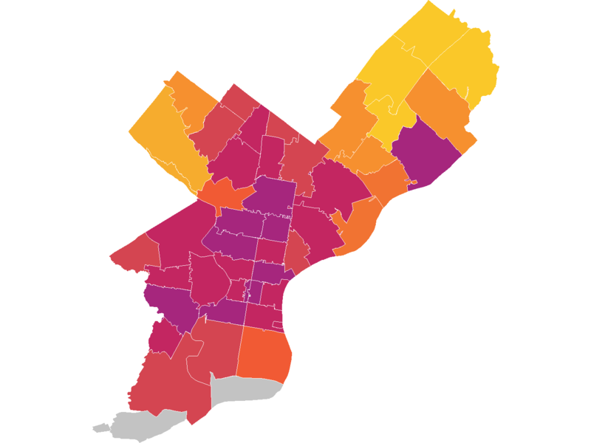
Rates of Persons Living with an HIV or AIDS Diagnosis, by ZIP Code, Philadelphia, 2012
* Data are not shown to protect privacy because of a small number of cases and/or a small population size.
Note. Data represent persons living with an HIV or AIDS diagnosis in the City of Philadelphia at the end of 2012 and who were reported as of 12/31/2013.
Data Source: Philadelphia Department of Public Health, AIDS Activities Coordinating Office.
Notes:
Rates of Persons Living with an HIV or AIDS Diagnosis, by ZIP Code, Philadelphia, 2012
This map shows the reported ZIP-code-level rates (per 100,000 population) of persons living with an HIV or AIDS diagnosis in Philadelphia at the end of 2012.
Data reflect cases reported through 12/31/2013. Cases without ZIP code for residence at diagnosis were excluded.
Persons living with an HIV or AIDS diagnosis are classified as adult or adolescent based on age at end of 2012.
More information about AIDSVu's data methods and sources can be found at www.aidsvu.org.

Slide 36
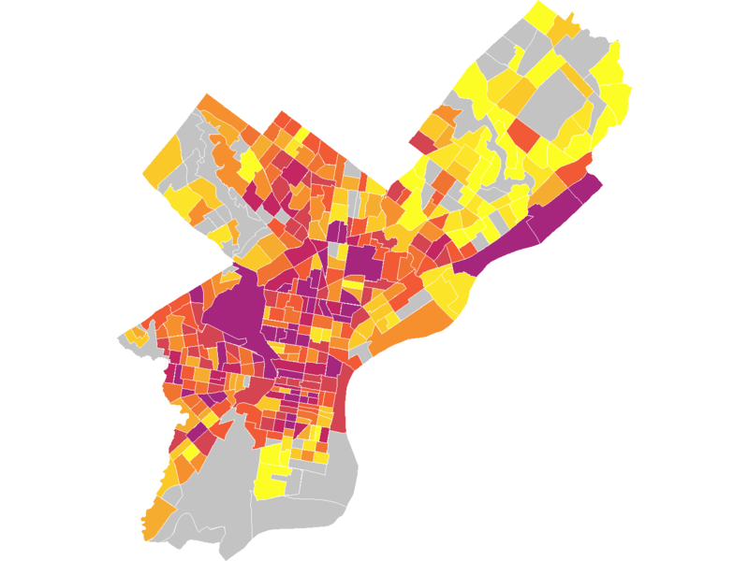
Rates of Persons Living with an HIV or AIDS Diagnosis, by ZIP Code & Census Tract, Philadelphia, 2012
Zip Code Rates
Census Tract Rates
* Data are not shown to protect privacy because of a small number of cases and/or a small population size.
Note. Data represent persons living with an HIV or AIDS diagnosis in the City of Philadelphia at the end of 2012 and who were reported as of 12/31/2013.
Data Source: Philadelphia Department of Public Health, AIDS Activities Coordinating Office.
Notes:
Rates of Persons Living with an HIV or AIDS Diagnosis, by ZIP Code & Census Tract, Philadelphia, 2012
These maps show a comparison of the reported ZIP-code-level and census-tract-level rates (per 100,000 population) of persons living with an HIV or AIDS diagnosis in Philadelphia at the end of 2012.
Data reflect cases reported through 12/31/2013. Cases without ZIP code for residence at diagnosis were excluded. Census tracts were assigned based on residence at diagnosis (when available), or earliest residence reported.
Persons living with an HIV or AIDS diagnosis are classified as adult or adolescent based on age at end of 2012.
More information about AIDSVu's data methods and sources can be found at www.aidsvu.org.

Slide 37
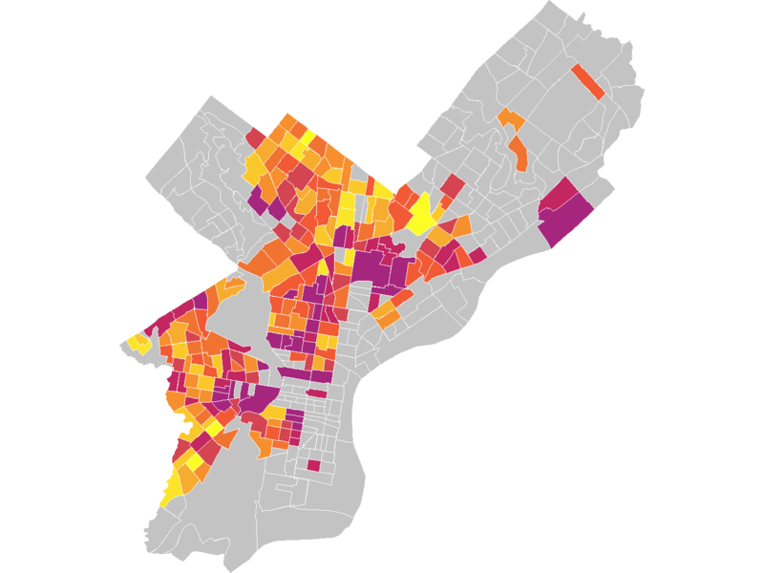
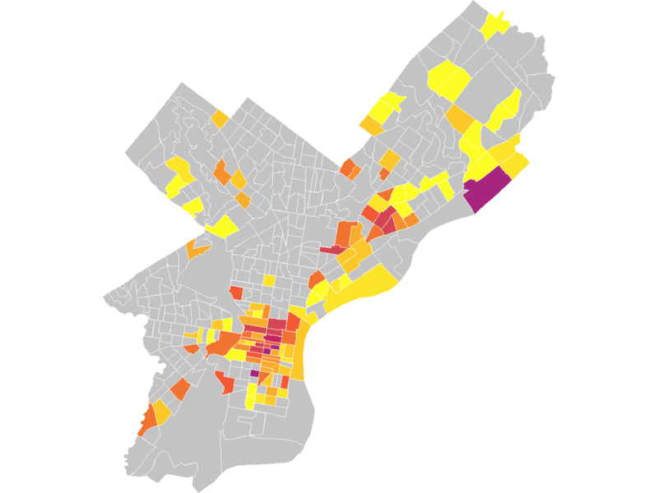
Rates of Black and White Persons Living with an HIV or AIDS Diagnosis, by Census Tract, Philadelphia, 2012
Black Rates
White Rates
* Data are not shown to protect privacy because of a small number of cases and/or a small population size.
Note. Data represent persons living with an HIV or AIDS diagnosis in the City of Philadelphia at the end of 2012 and who were reported as of 12/31/2013.
Data Source: Philadelphia Department of Public Health, AIDS Activities Coordinating Office.
Notes:
Rates of Persons Living with an HIV or AIDS Diagnosis, by ZIP Code & Census Tract, Philadelphia, 2012
These maps show a comparison of the reported ZIP-code-level and census-tract-level rates (per 100,000 population) of persons living with an HIV or AIDS diagnosis in Philadelphia at the end of 2012.
Data reflect cases reported through 12/31/2013. Cases without ZIP code for residence at diagnosis were excluded. Census tracts were assigned based on residence at diagnosis (when available), or earliest residence reported.
Persons living with an HIV or AIDS diagnosis are classified as adult or adolescent based on age at end of 2012.
More information about AIDSVu's data methods and sources can be found at www.aidsvu.org.

Slide 38
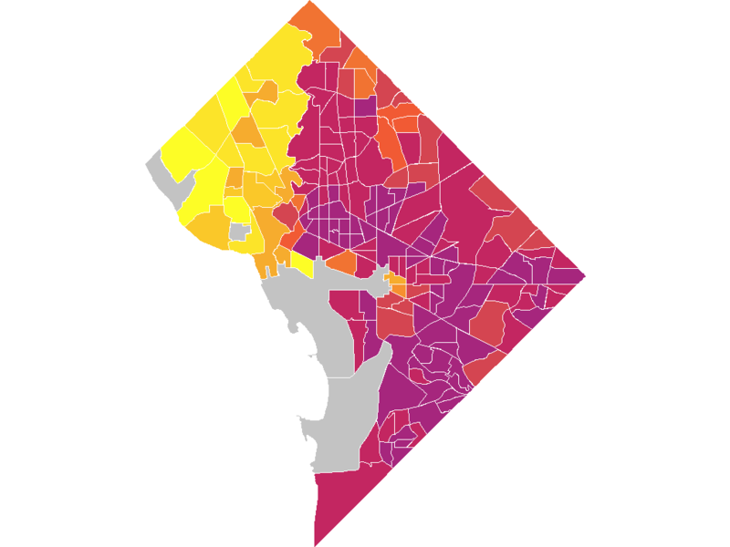
Rates of Persons Living with an HIV or AIDS Diagnosis, by Census Tract, Washington, D.C., 2012
* Data are not shown to protect privacy because of a small number of cases and/or a small population size.
Notes. Data represent persons living with an HIV or AIDS diagnosis in the District of Columbia at the end of 2012 and who were reported as of 12/31/2014. Data Source: District of Columbia Department of Health, HIV/AIDS, Hepatitis, STD and TB Administration.
Notes:
Rates of Persons Living with an HIV or AIDS Diagnosis, by Census Tract, Washington, D.C., 2012.
This map shows the reported census-tract-level rates (per 100,000 population) of persons living with an HIV or AIDS diagnosis in Washington, D.C. at the end of 2012.
Data reflect cases reported through 12/31/2014 and are based on residence at diagnosis as reported in District of Columbia's Enhanced HIV/AIDS Reporting System (eHARS).
Census tracts were assigned based on residence at diagnosis (when available), or earliest residence reported.
Persons living with an HIV or AIDS diagnosis are classified as adult or adolescent based on age at end of 2012.
More information about AIDSVu's data methods and sources can be found at www.aidsvu.org.

Slide 39
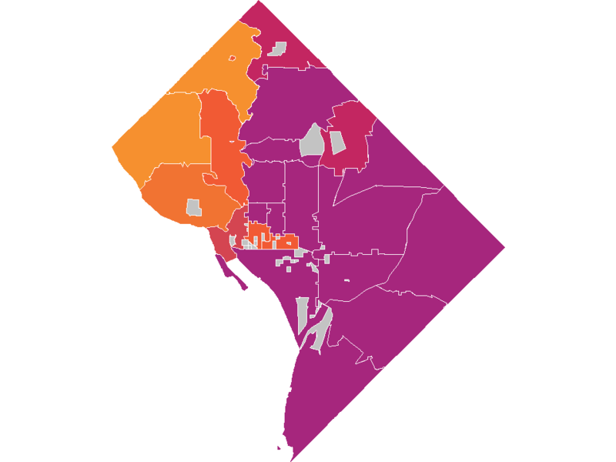
Rates of Persons Living with an HIV or AIDS Diagnosis, by ZIP Code & Census Tract, Washington, D.C., 2012
ZIP Code Rates
Census Tract Rates
* Data are not shown to protect privacy because of a small number of cases and/or a small population size.
Notes. Data represent persons living with an HIV or AIDS diagnosis in the District of Columbia at the end of 2012 and who were reported as of 12/31/2014. Data Source: District of Columbia Department of Health, HIV/AIDS, Hepatitis, STD and TB Administration.
Notes:
Rates of Persons Living with an HIV or AIDS Diagnosis, by ZIP Code & Census Tract, Washington, D.C., 2012.
These maps show a comparison of the reported ZIP-code-level and census-tract-level rates (per 100,000 population) of persons living with an HIV or AIDS diagnosis in Washington, D.C. at the end of 2012.
Data reflect cases reported through 12/31/2014 and are based on residence at diagnosis as reported in District of Columbia's Enhanced HIV/AIDS Reporting System (eHARS).
Cases without ZIP Code for residence at diagnosis were excluded.
Census tracts were assigned based on residence at diagnosis (when available), or earliest residence reported.
Persons living with an HIV or AIDS diagnosis are classified as adult or adolescent based on age at end of 2012.
More information about AIDSVu's data methods and sources can be found at www.aidsvu.org.

Slide 40
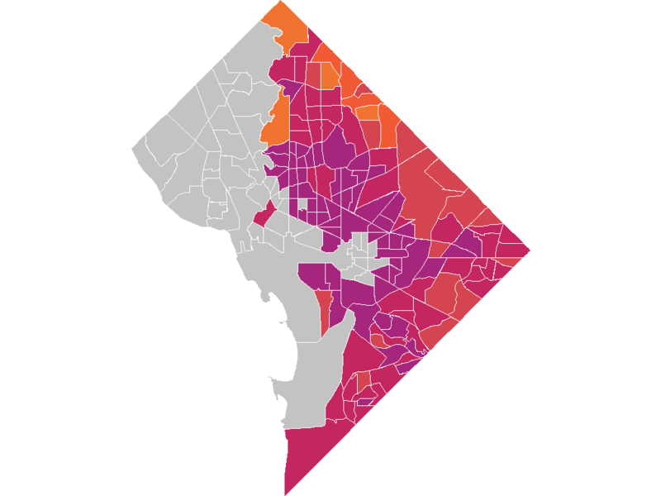
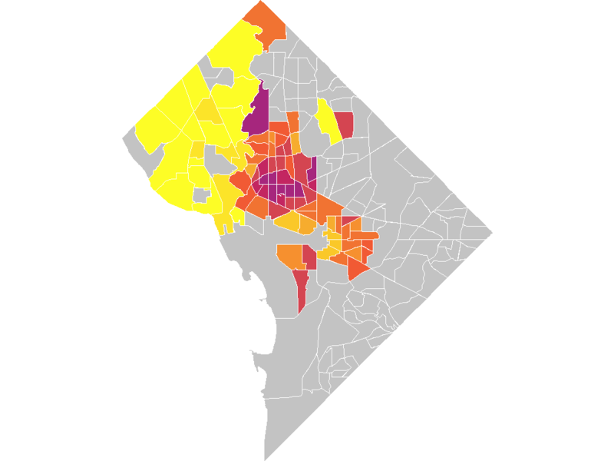
Rates of Black & White Persons Living with an HIV or AIDS Diagnosis, by Census Tract, Washington, D.C., 2012
Black Rates
White Rates
* Data are not shown to protect privacy because of a small number of cases and/or a small population size.
Notes. Data represent persons living with an HIV or AIDS diagnosis in the District of Columbia at the end of 2012 and who were reported as of 12/31/2014. Data Source: District of Columbia Department of Health, HIV/AIDS, Hepatitis, STD and TB Administration.
Notes:
Rates of Black & White Persons Living with an HIV or AIDS Diagnosis, by Census Tract, Washington, D.C., 2012.
These maps show a comparison of the reported census-tract-level rates (per 100,000 population) of black & white persons living with an HIV or AIDS diagnosis in Washington, D.C. at the end of 2012.
Data reflect cases reported through 12/31/2014 and are based on residence at diagnosis as reported in District of Columbia's Enhanced HIV/AIDS Reporting System (eHARS).
Census tracts were assigned based on residence at diagnosis (when available), or earliest residence reported.
Persons living with an HIV or AIDS diagnosis are classified as adult or adolescent based on age at end of 2012.
More information about AIDSVu's data methods and sources can be found at www.aidsvu.org.

Slide 41
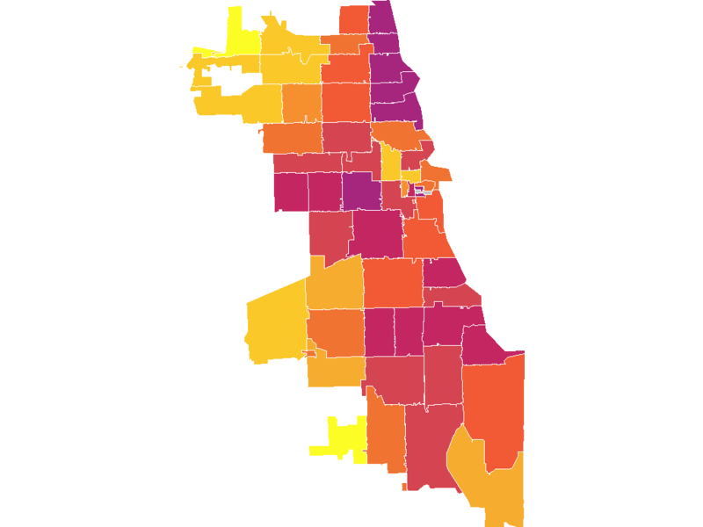
Rates of Persons Living with an HIV or AIDS Diagnosis, by ZIP Code, Chicago, 2012
* Data are not shown to protect privacy because of a small number of cases and/or a small population size.
Notes. Data represent persons living with an HIV or AIDS diagnosis in the City of Chicago at the end of 2012 and who were reported as of 09/30/2014. Data Source: Chicago Department of Public Health, STI/HIV Division, Surveillance, Epidemiology and Research Section.
Notes:
Rates of Persons Living with an HIV or AIDS Diagnosis, by ZIP Code, Chicago, 2012. This map shows the reported ZIP-code-level rates (per 100,000 population) of persons living with an HIV or AIDS diagnosis in Chicago at the end of 2012. Data reflect cases reported through 09/30/2014 as reported in Chicago's Enhanced HIV/AIDS Reporting System (eHARS). Homeless cases and those cases missing an address at diagnosis were omitted. Cases with an address at diagnosis and no ZIP Code data were geocoded to obtain ZIP Code information. Persons living with an HIV or AIDS diagnosis are classified as adult or adolescent based on age at end of 2012. More information about AIDSVu's data methods and sources can be found at www.aidsvu.org.

Slide 42
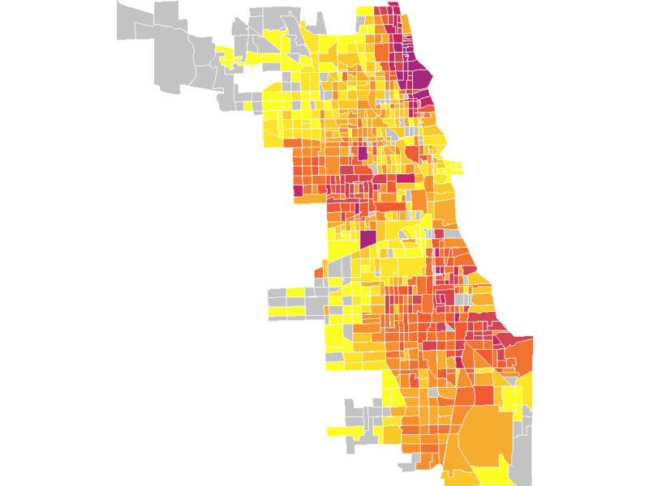
Rates of Persons Living with an HIV or AIDS Diagnosis, by ZIP Code & Census Tract, Chicago, 2012
Zip Code Rates
Census Tract Rates
* Data are not shown to protect privacy because of a small number of cases and/or a small population size.
Note. Data represent persons living with an HIV or AIDS diagnosis in the City of Chicago at the end of 2012 and who were reported as of 09/30/2014.
Data Source: Chicago Department of Public Health, STI/HIV Division, Surveillance, Epidemiology and Research Section
Notes:
Rates of Persons Living with an HIV or AIDS Diagnosis, by ZIP Code & Census Tract, Chicago, 2012
These maps show a comparison of the reported ZIP-code-level and census-tract-level rates (per 100,000 population) of persons living with an HIV or AIDS diagnosis in Chicago at the end of 2012.
Data reflect cases reported through 12/31/2013. Cases without ZIP code for residence at diagnosis were excluded. Census tracts were assigned based on residence at diagnosis (when available), or earliest residence reported.
Persons living with an HIV or AIDS diagnosis are classified as adult or adolescent based on age at end of 2012.
More information about AIDSVu's data methods and sources can be found at www.aidsvu.org.

Slide 43
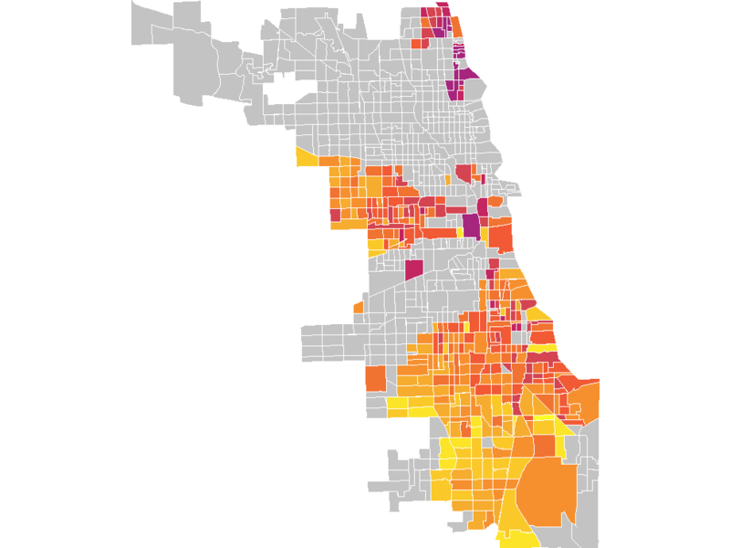
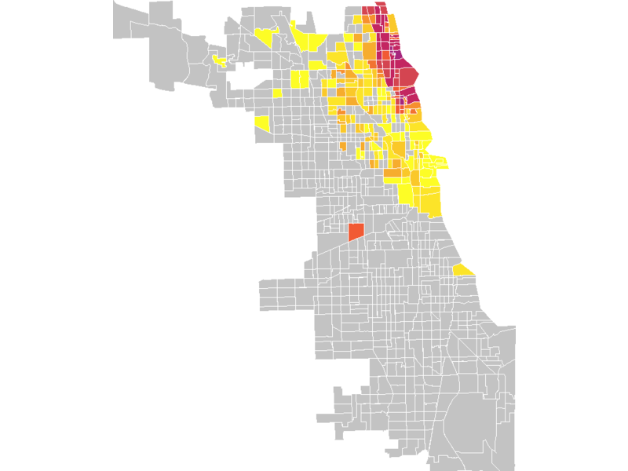
Rates of Black & White Persons Living with an HIV or AIDS Diagnosis, by Census Tract, Chicago, 2012
Black Rates
White Rates
* Data are not shown to protect privacy because of a small number of cases and/or a small population size.
Notes. Data represent persons living with an HIV or AIDS diagnosis in the City of Chicago at the end of 2012 and who were reported as of 09/30/2014. Data Source: Chicago Department of Public Health, STI/HIV Division, Surveillance, Epidemiology and Research Section.
Notes:
Rates of Black & White Persons Living with an HIV or AIDS Diagnosis, by Census Tract, Chicago, 2012.
These maps show a comparison of the reported census-tract-level rates (per 100,000 population) of black & white persons living with an HIV or AIDS diagnosis in Chicago at the end of 2012.
Data reflect cases reported through 09/30/2014 and are based on residence at diagnosis as reported in Chicago's Enhanced HIV/AIDS Reporting System (eHARS).
Census tracts were assigned based on residence at diagnosis (when available), or earliest residence reported.
Persons living with an HIV or AIDS diagnosis are classified as adult or adolescent based on age at end of 2012.
More information about AIDSVu's data methods and sources can be found at www.aidsvu.org.

Slide 44
Caveats & Limitations of AIDSVu Maps
Data on AIDSVu may differ from data released in state and local HIV surveillance reports.
Maps are inclusive of incarcerated persons and should be interpreted with caution.
AIDSVu maps do not reflect undiagnosed cases.
Caution should be exercised when comparing maps because the scales change when viewing data overall and by race/ethnicity, sex and age group breakdowns.
Notes:
HIV prevalence data on AIDSVu may differ slightly from data released by state and local HIV surveillance programs because of different analysis criteria and because data released from CDC has been de-duplicated on a national basis.
Caution should be exercised when interpreting county, ZIP Code, census tract, and neighborhood data as these statistics are inclusive of incarcerated persons and their inclusion may artificially inflate the actual rate and case count when an institution is housed within it. See AIDSVu’s Data Methods for details regarding this limitation.
AIDSVu maps do not reflect undiagnosed cases.
Caution should be exercised when comparing maps because the scales change when viewing data overall and by race/ethnicity, sex and age group breakdowns.
Comparisons should not be made between AIDSVu’s state and county maps and its ZIP Code/census tract/neighborhood maps because the data sources are different.

Slide 45
Additional Resources
For maps of state- and county-level data that include HIV and other sexually transmitted infections (STIs), visit the CDC’s National Center for HIV/AIDS, Viral Hepatitis, STD and TB Prevention (NCHHSTP) Atlas: www.cdc.gov/nchhstp/atlas/
For more information about HIV prevention, visit: www.cdc.gov/hiv/strategy/hihp/ and http://aids.gov/federal-resources/hiv-aids-programs/prevention-programs/index.html
For additional health facts and HIV/AIDS policy fact sheets, visit the Kaiser Family Foundation’s website: www.kff.org/hivaids/index.cfm

Slide 46
Contact AIDSVu
More map views, downloadable maps and additional resources are available online at www.aidsvu.org.
For more information about AIDSVu, including information about custom map views and images, please email info@aidsvu.org.

Slide 47
Index
About AIDSVu Slide 2
AIDSVu Features Slides 3-5
Supporting the National HIV/AIDS Strategy Slide 6
AIDSVu National Maps Slides 7-20
AIDSVu Southeastern U.S. Maps Slides 21-23
AIDSVu Social Determinants of Health Maps Slides 24-28
AIDSVu Transmission Category Maps Slides 29-34
AIDSVu ZIP Code and Census Tract Maps Slides 35-43
Caveats & Limitations of AIDSVu Maps Slide 44
Additional Resources Slide 45
Contact AIDSVu Slide 46

