Slide 1
Illustrating HIV/AIDS in the United States
2016 Update

Slide 2
About AIDSVu
AIDSVu is a compilation of interactive, online maps that allows users to visually explore the HIV epidemic in the U.S. alongside critical resources, such as HIV testing and treatment center locations.
AIDSVu’s mission is to make HIV data widely accessible and locally relevant.
AIDSVu provides users with an intuitive, visual way to connect with complex information about persons living with diagnosed HIV and new HIV diagnoses at national, state, and local levels.
Notes:
AIDSVu is a compilation of interactive, online maps that allows users to visually explore the HIV epidemic in the U.S. alongside critical resources, such as HIV testing and treatment center locations.
AIDSVu’s mission is to make HIV data widely accessible and locally relevant.
AIDSVu provides users with an intuitive, visual way to connect with complex information about persons living with diagnosed HIV and new HIV diagnoses at national, state, and local levels.

Slide 3
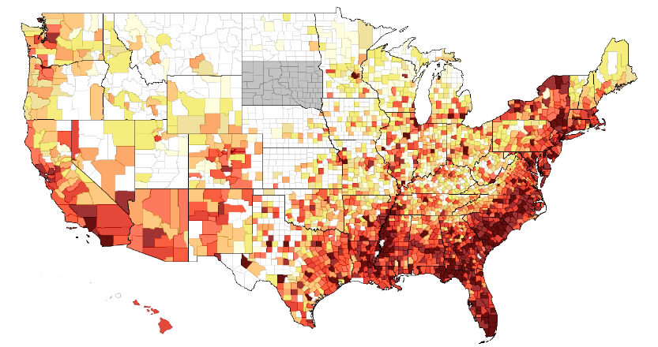
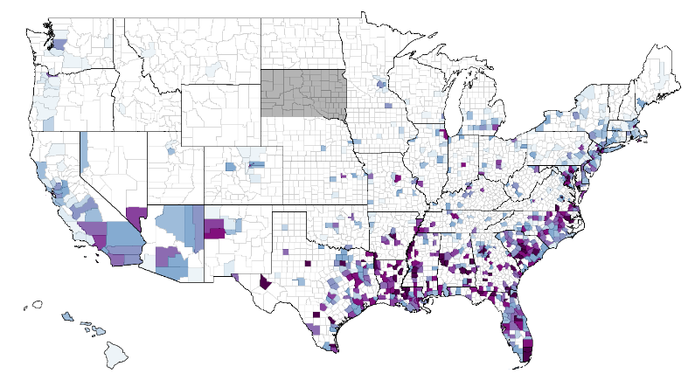
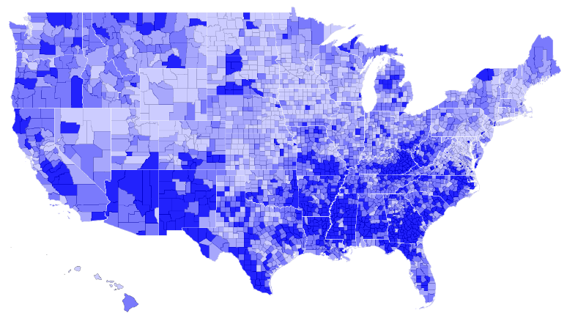
Interactive Maps
National, State, and Local Maps
Persons living with diagnosed HIV by state, county, ZIP Code, census tract, and neighborhood
Persons newly diagnosed with HIV by state, county, ZIP Code, census tract, and neighborhood
Deaths of persons diagnosed with HIV
Social determinants of health (e.g., poverty, insurance, education)
HIV transmission modes
Service Locators
HIV testing and treatment center locations
NIH-funded HIV Prevention, Vaccine & Treatment Trials Sites
Housing Opportunities for People with AIDS
Notes:
AIDSVu uses data from multiple trusted sources to populate its interactive maps.
In order to be able to compare data between jurisdictions, AIDSVu’s state- and county-level prevalence and new diagnoses data come from the U.S. Centers for Disease Control and Prevention (CDC). ZIP Code, census tract, and neighborhood data come directly from jurisdictions’ health departments. AIDSVu data do not reflect undiagnosed cases.
Other data available on AIDSVu include:
State-level mortality data (deaths of persons diagnosed with HIV)
Social determinants of health data at the state and county level
HIV testing and treatment center locations
NIH-funded HIV Prevention, Vaccine & Treatment Trials Sites
Housing Opportunities for People with AIDS

Slide 4
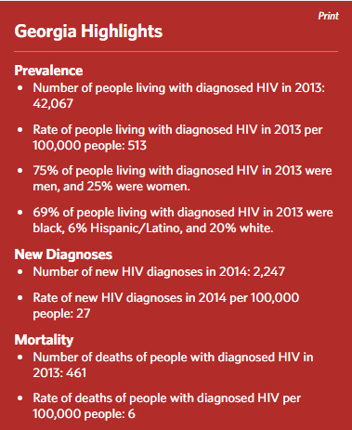
Local Statistics
State and City Profiles
Demographic information
HIV prevalence rate ratios by
race/ethnicity
HIV transmission modes, late diagnoses,
and mortality data
State HIV prevention progress
HIV/AIDS federal grant funding and
programs
STD quick facts
Website links for city- and state-level
HIV/AIDS resources
Notes:
AIDSVu provides detailed information on City and State Profile pages, including more data about HIV and other sexually transmitted diseases in the city and state, and links to local and state health departments’ websites for HIV/AIDS.

Slide 5
Other AIDSVu Features
HIV Testing Site Locator
CDC National Prevention Information Network
Search by ZIP Code or city & state
HIV Treatment Site Locator
Ryan White HIV/AIDS Medical Care Providers
Search by ZIP Code or city & state
Downloadable Resources
Slide decks with high-resolution maps
Data sets

Slide 6
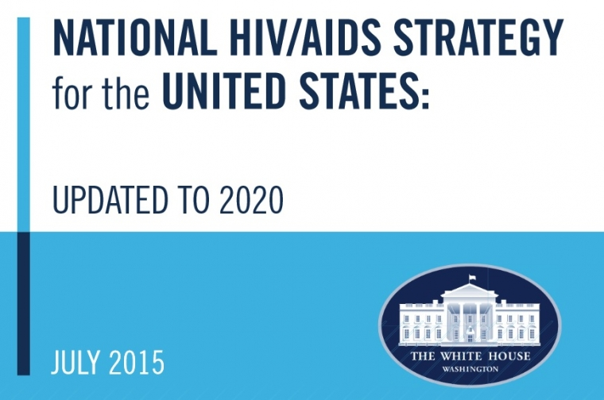
AIDSVu: Supporting the National HIV/AIDS Strategy
Prevent new HIV infections
Improve linkage to prevention, care, and treatment
Reduce HIV-related health disparities
Notes:
AIDSVu can play a direct role in supporting the National HIV/AIDS Strategy goals.
AIDSVu images can increase a community’s awareness of the problem and lead directly to more action to prevent new HIV infections.
AIDSVu helps users to take action on the information they’ve learned, such as locating sites to get an HIV test, and finding other prevention, care, and treatment resources.
AIDSVu can also be a resource to identify areas and populations most highly affected by HIV, and where HIV prevention resources may be most needed and most impactful.

Slide 7
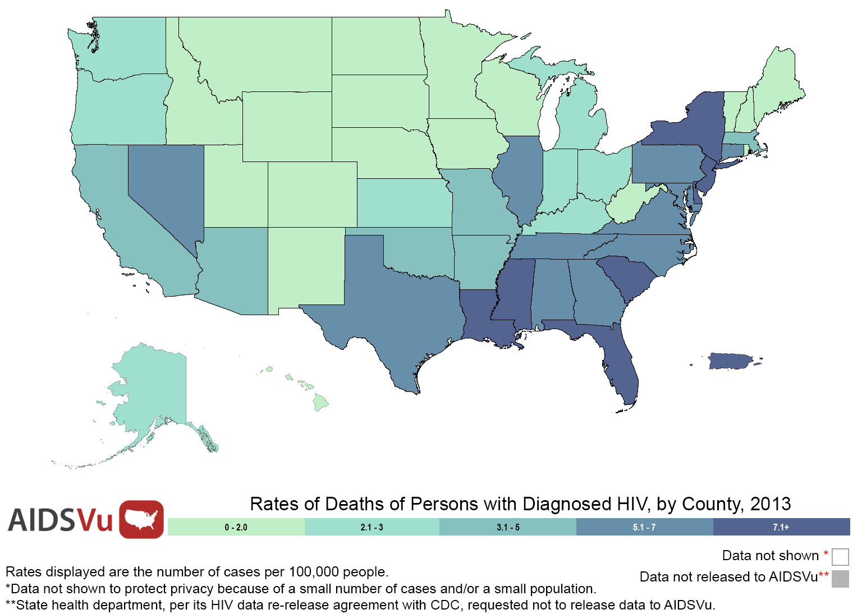
Rates of Deaths of Persons with Diagnosed HIV, by State, 2013
Notes:
Rates of Deaths of Persons with Diagnosed HIV, by State, 2013
These maps show the estimated state-level rates (per 100,000 population) of deaths of persons with diagnosed HIV at the end of 2013.
Data include deaths of adults and adolescents diagnosed with HIV, regardless of the stage of disease at diagnosis, and have been statistically adjusted to account for reporting delays and missing risk-factor information, but not for incomplete reporting. Data reflect all-cause related deaths and include deaths due to HIV.
Data were released to AIDSVu in accordance with state health departments' HIV surveillance data re-release agreements with CDC.
More information about AIDSVu's data methods and sources can be found at www.aidsvu.org.

Slide 8
Rates of Persons Newly Diagnosed with HIV, by State, 2014
Notes:
Rates of Persons Newly Diagnosed with HIV, by State, 2014
These maps show the estimated state-level rates (per 100,000 population) of adults and adolescents newly diagnosed with HIV at the end of 2014.
Data include adults and adolescents living with a diagnosis of HIV infection, regardless of the stage of disease at diagnosis, and have been statistically adjusted to account for reporting delays and missing risk-factor information, but not for incomplete reporting.
Data were released to AIDSVu in accordance with state health departments' HIV surveillance data re-release agreements with CDC.
More information about AIDSVu's data methods and sources can be found at www.aidsvu.org.

Slide 9
Rates of Persons Newly Diagnosed with HIV, by County, 2014
Notes:
Rates of Persons Newly Diagnosed with HIV, by County, 2014
These maps show the estimated county-level rates (per 100,000 population) of adults and adolescents newly diagnosed with HIV at the end of 2014.
Data include adults and adolescents living with a diagnosis of HIV infection, regardless of the stage of disease at diagnosis, and have been statistically adjusted to account for reporting delays and missing risk-factor information, but not for incomplete reporting.
There are no counties in Alaska, the District of Columbia, and Puerto Rico.
Data were released to AIDSVu in accordance with state health departments' HIV surveillance data re-release agreements with CDC.
More information about AIDSVu's data methods and sources can be found at www.aidsvu.org.

Slide 10
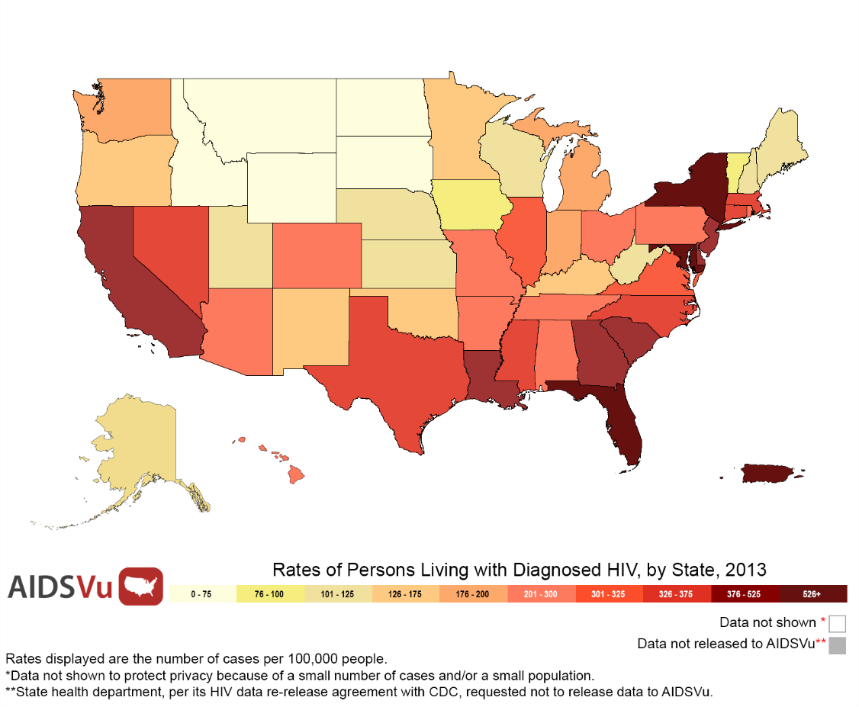
Rates of Persons Living with Diagnosed HIV, by State, 2013
Notes:
Rates of Persons Living with Diagnosed HIV, by State, 2013
This map shows the estimated state-level rates (per 100,000 population) of adults and adolescents living with diagnosed HIV at the end of 2013.
Data include adults and adolescents living with a diagnosis of HIV infection, regardless of the stage of disease at diagnosis, and have been statistically adjusted to account for reporting delays and missing risk-factor information, but not for incomplete reporting.
Persons living with diagnosed HIV are classified as adult or adolescent based on age (13 or greater) at end of 2013.
Data were released to AIDSVu in accordance with state health departments' HIV surveillance data re-release agreements with CDC.
More information about AIDSVu's data methods and sources can be found at www.aidsvu.org

Slide 11
Rates of Persons Living with Diagnosed HIV, by County, 2013
Notes:
Rates of Persons Living with Diagnosed HIV, by County, 2013
This map shows the estimated county-level rates (per 100,000 population) of adults and adolescents living with diagnosed HIV at the end of 2013.
Data include adults and adolescents living with a diagnosis of HIV infection, regardless of the stage of disease at diagnosis, and have been statistically adjusted to account for reporting delays and missing risk-factor information, but not for incomplete reporting.
Persons living with diagnosed HIV are classified as adult or adolescent based on age at end of 2013.
There are no counties in Alaska, the District of Columbia, and Puerto Rico.
Data were released to AIDSVu in accordance with state health departments' HIV surveillance data re-release agreements with CDC.
More information about AIDSVu's data methods and sources can be found at www.aidsvu.org.

Slide 12
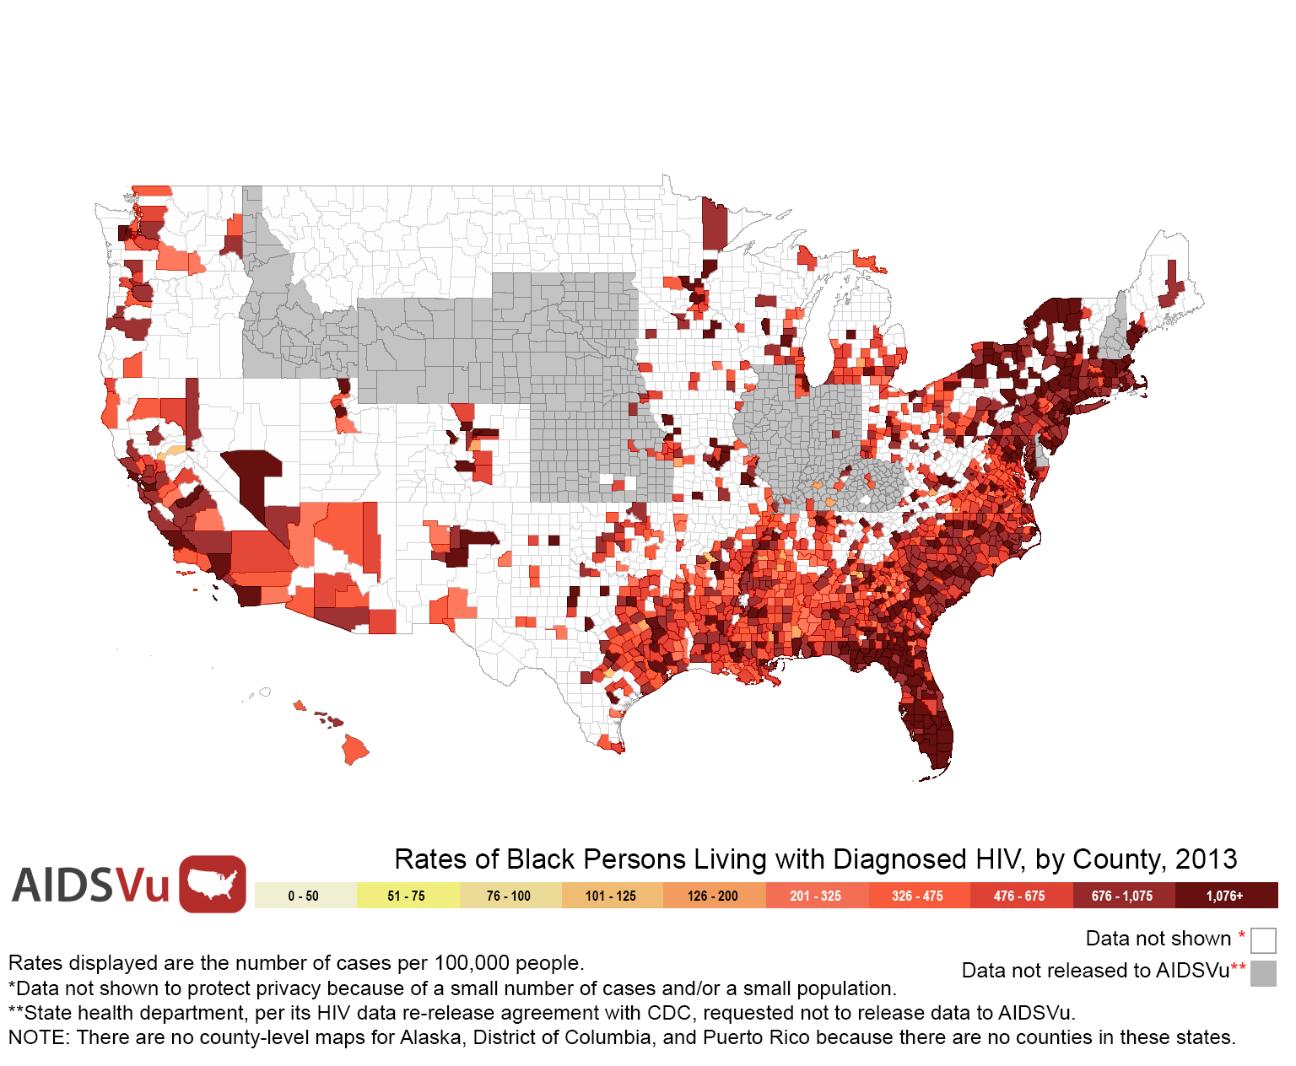
Rates of Black Persons Living with Diagnosed HIV, by County, 2013
Notes:
Rates of Black Persons Living with Diagnosed HIV, by County, 2013
This map shows the estimated county-level rates (per 100,000 population) of black adults and adolescents living with diagnosed HIV at the end of 2013.
Data include adults and adolescents living with a diagnosis of HIV infection, regardless of the stage of disease at diagnosis, and have been statistically adjusted to account for reporting delays and missing risk-factor information, but not for incomplete reporting.
Persons living with diagnosed HIV are classified as adult or adolescent based on age at end of 2013.
There are no counties in Alaska, the District of Columbia, and Puerto Rico.
Data were released to AIDSVu in accordance with state health departments' HIV surveillance data re-release agreements with CDC.
More information about AIDSVu's data methods and sources can be found at www.aidsvu.org.

Slide 13
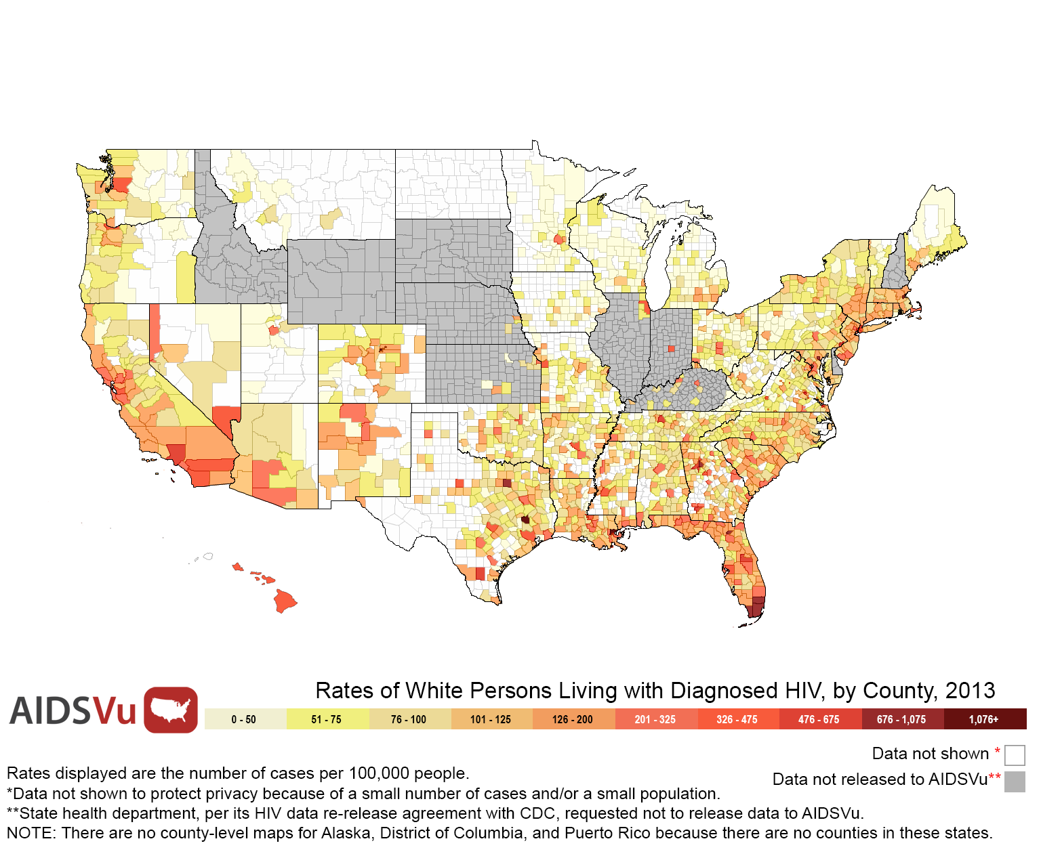
Rates of White Persons Living with Diagnosed HIV, by County, 2013
Notes:
Rates of White Persons Living with Diagnosed HIV, by County, 2013
This map shows the estimated county-level rates (per 100,000 population) of white adults and adolescents living with diagnosed HIV at the end of 2013.
Data include adults and adolescents living with a diagnosis of HIV infection, regardless of the stage of disease at diagnosis, and have been statistically adjusted to account for reporting delays and missing risk-factor information, but not for incomplete reporting.
Persons living with diagnosed HIV are classified as adult or adolescent based on age at end of 2013.
There are no counties in Alaska, the District of Columbia, and Puerto Rico.
Data were released to AIDSVu in accordance with state health departments' HIV surveillance data re-release agreements with CDC.
More information about AIDSVu's data methods and sources can be found at www.aidsvu.org.

Slide 14
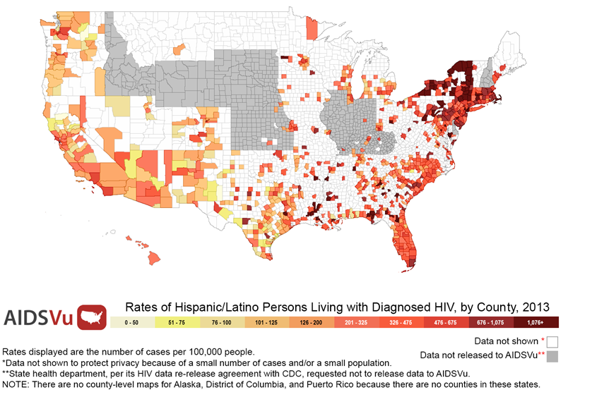
Rates of Hispanic/Latino Persons Living with Diagnosed HIV, by County, 2013
Notes:
Rates of Hispanic/Latino Persons Living with Diagnosed HIV, by County, 2013
This map shows the estimated county-level rates (per 100,000 population) of Hispanic/Latino adults and adolescents living with diagnosed HIV at the end of 2013.
Data include adults and adolescents living with a diagnosis of HIV infection, regardless of the stage of disease at diagnosis, and have been statistically adjusted to account for reporting delays and missing risk-factor information, but not for incomplete reporting.
Persons living with diagnosed HIV are classified as adult or adolescent based on age at end of 2013.
There are no counties in Alaska, the District of Columbia, and Puerto Rico.
Data were released to AIDSVu in accordance with state health departments' HIV surveillance data re-release agreements with CDC.
More information about AIDSVu's data methods and sources can be found at www.aidsvu.org.

Slide 15
Rates of Black & White Persons Living with Diagnosed HIV, by County, 2013
Black Rates
White Rates
Notes:
Rates of Black & White Persons Living with Diagnosed HIV, by County, 2013
These maps show a comparison of the estimated county-level rates (per 100,000 population) of black & white adults and adolescents living with diagnosed HIV at the end of 2013.
Data include adults and adolescents living with a diagnosis of HIV infection, regardless of the stage of disease at diagnosis, and have been statistically adjusted to account for reporting delays and missing risk-factor information, but not for incomplete reporting.
Persons living with diagnosed HIV are classified as adult or adolescent based on age at end of 2013.
There are no counties in Alaska, the District of Columbia, and Puerto Rico.
Data were released to AIDSVu in accordance with state health departments' HIV surveillance data re-release agreements with CDC.
More information about AIDSVu's data methods and sources can be found at www.aidsvu.org.

Slide 16
Rates of Hispanic/Latino & White Persons Living with Diagnosed HIV, by County, 2013
Hispanic/Latino Rates
White Rates
Notes:
Rates of Hispanic/Latino & White Persons Living with Diagnosed HIV, by County, 2013
These maps show a comparison of the estimated county-level rates (per 100,000 population) of Hispanic/Latino & white adults and adolescents living with diagnosed HIV at the end of 2013.
Data include adults and adolescents living with a diagnosis of HIV infection, regardless of the stage of disease at diagnosis, and have been statistically adjusted to account for reporting delays and missing risk-factor information, but not for incomplete reporting.
Persons living with diagnosed HIV are classified as adult or adolescent based on age at end of 2013.
There are no counties in Alaska, the District of Columbia, and Puerto Rico.
Data were released to AIDSVu in accordance with state health departments' HIV surveillance data re-release agreements with CDC.
More information about AIDSVu's data methods and sources can be found at www.aidsvu.org.

Slide 17
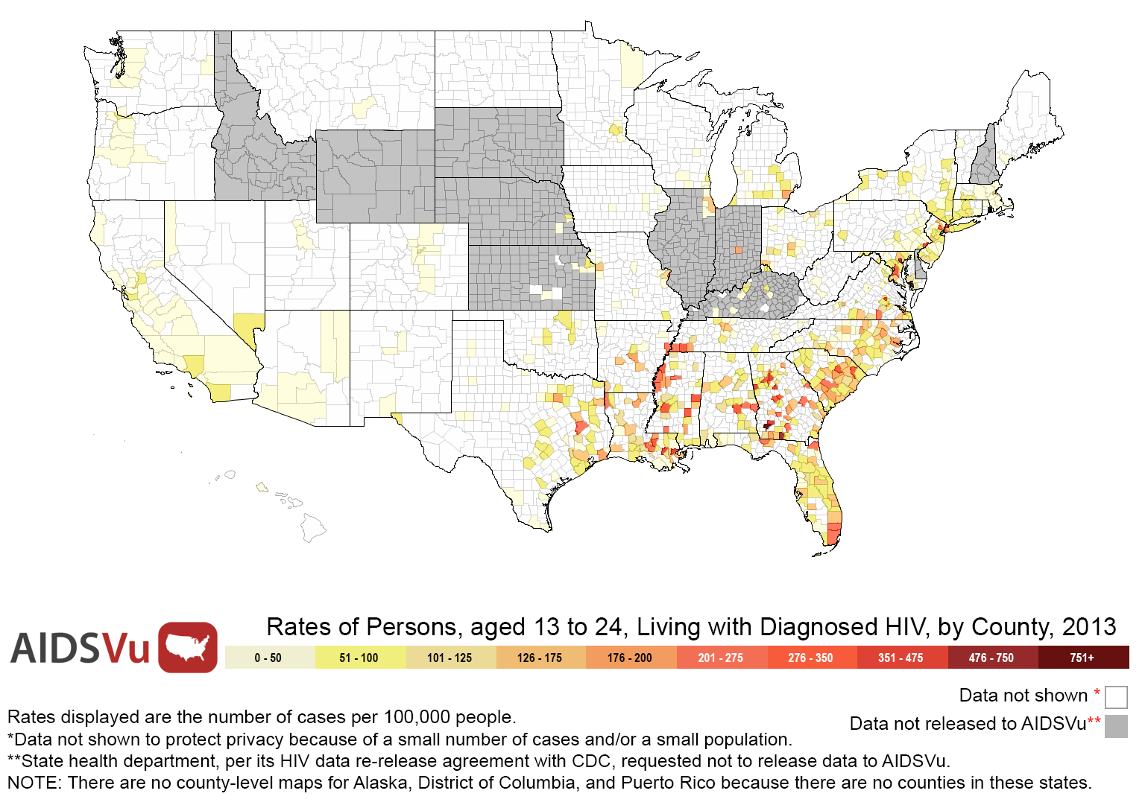
Rates of Persons, aged 13-24, Living with Diagnosed HIV, by County, 2013
Notes:
Rates of Persons, aged 13-24, Living with Diagnosed HIV, by County, 2013
This map shows the estimated county-level rates (per 100,000 population) of adults and adolescents aged 13-24 living with diagnosed HIV at the end of 2013.
Data include adults and adolescents living with a diagnosis of HIV infection, regardless of the stage of disease at diagnosis, and have been statistically adjusted to account for reporting delays and missing risk-factor information, but not for incomplete reporting.
Persons living with diagnosed HIV are classified as adult or adolescent based on age at end of 2013.
There are no counties in Alaska, the District of Columbia, and Puerto Rico.
Data were released to AIDSVu in accordance with state health departments' HIV surveillance data re-release agreements with CDC.
More information about AIDSVu's data methods and sources can be found at www.aidsvu.org.

Slide 18
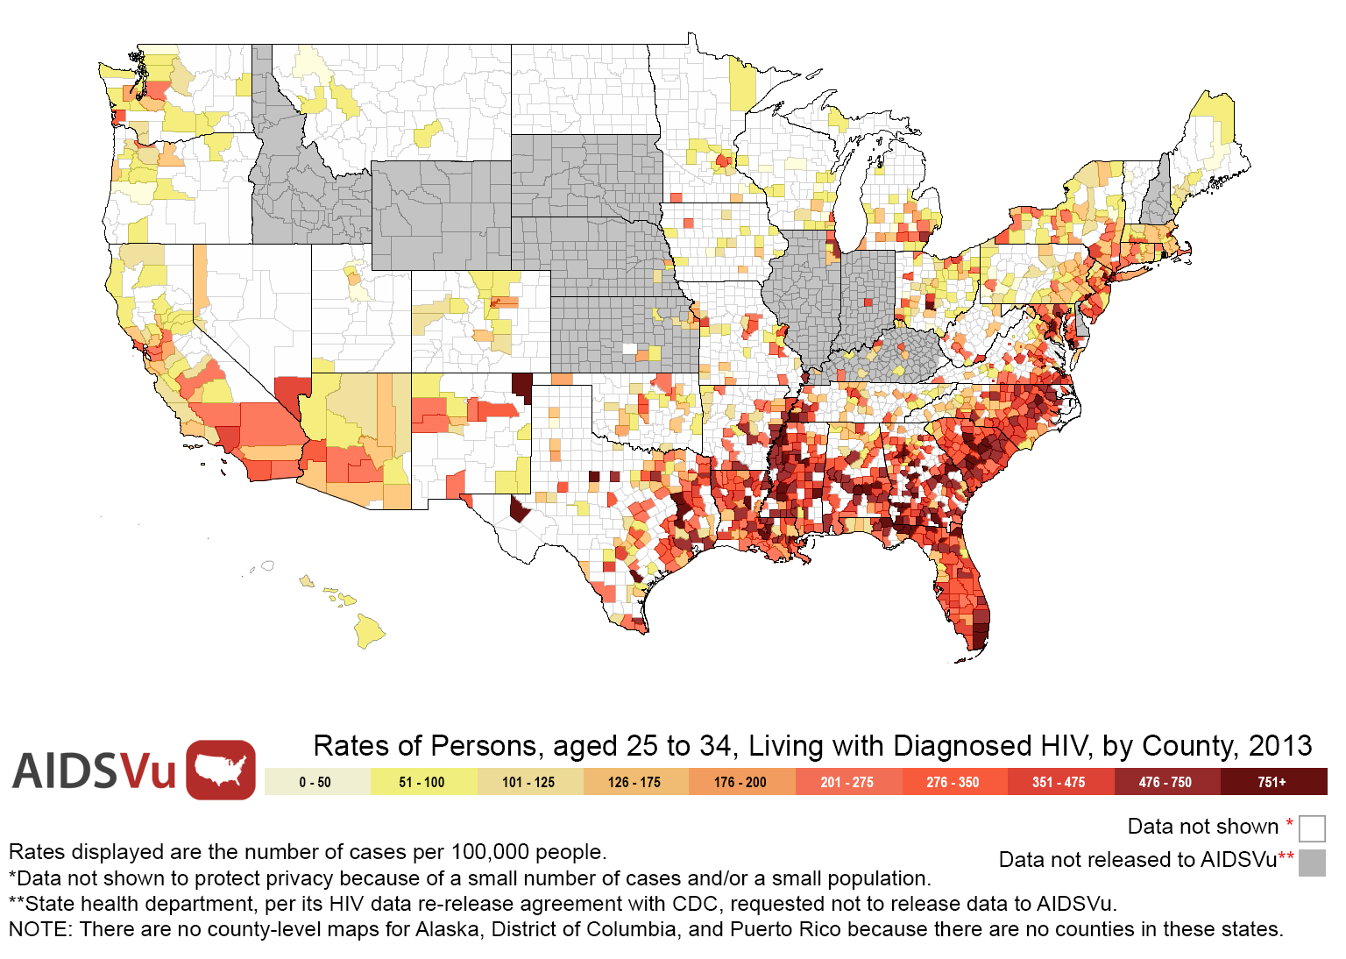
Rates of Persons, aged 25-34, Living with Diagnosed HIV, by County, 2013
Notes:
Rates of Persons, aged 25-34, Living with Diagnosed HIV, by County, 2013
This map shows the estimated county-level rates (per 100,000 population) of adults and adolescents aged 25-34 living with diagnosed HIV at the end of 2013.
Data include adults and adolescents living with a diagnosis of HIV infection, regardless of the stage of disease at diagnosis, and have been statistically adjusted to account for reporting delays and missing risk-factor information, but not for incomplete reporting.
Persons living with diagnosed HIV are classified as adult or adolescent based on age at end of 2013.
There are no counties in Alaska, the District of Columbia, and Puerto Rico.
Data were released to AIDSVu in accordance with state health departments' HIV surveillance data re-release agreements with CDC.
More information about AIDSVu's data methods and sources can be found at www.aidsvu.org.

Slide 19
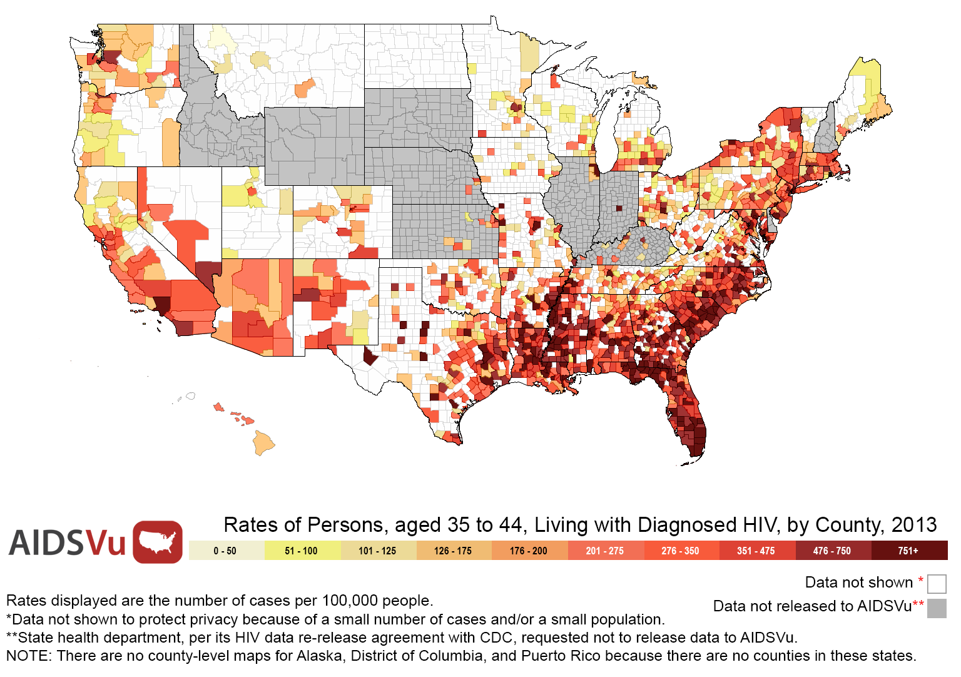
Rates of Persons, aged 35-44, Living with Diagnosed HIV, by County, 2013
Notes:
Rates of Persons, aged 35-44, Living with Diagnosed HIV, by County, 2013
This map shows the estimated county-level rates (per 100,000 population) of adults and adolescents aged 35-44 living with diagnosed HIV at the end of 2013.
Data include adults and adolescents living with a diagnosis of HIV infection, regardless of the stage of disease at diagnosis, and have been statistically adjusted to account for reporting delays and missing risk-factor information, but not for incomplete reporting.
Persons living with diagnosed HIV are classified as adult or adolescent based on age at end of 2013.
There are no counties in Alaska, the District of Columbia, and Puerto Rico.
Data were released to AIDSVu in accordance with state health departments' HIV surveillance data re-release agreements with CDC.
More information about AIDSVu's data methods and sources can be found at www.aidsvu.org.

Slide 20
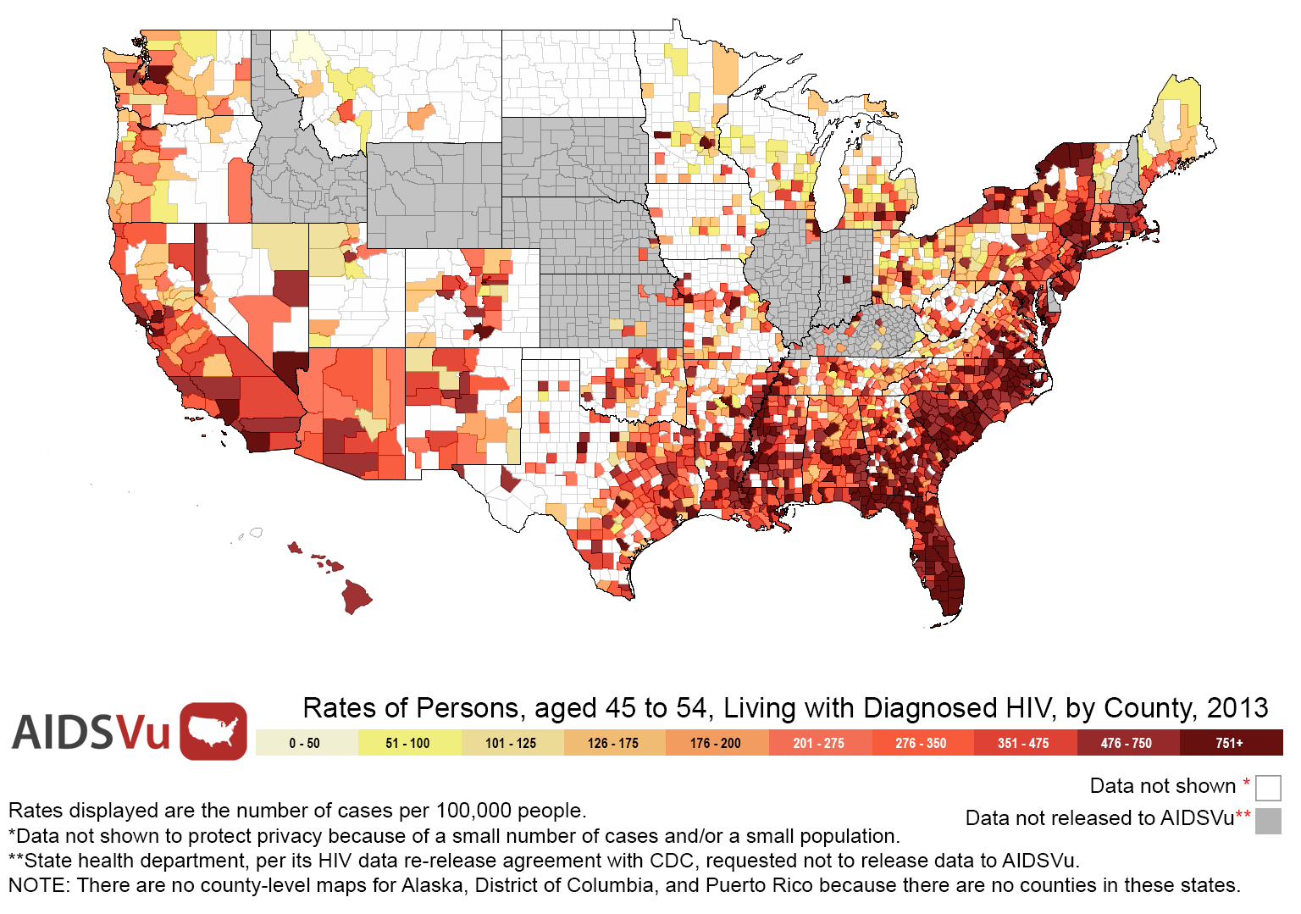
Rates of Persons, aged 45-54, Living with Diagnosed HIV, by County, 2013
Notes:
Rates of Persons, aged 45-54, Living with Diagnosed HIV, by County, 2013
This map shows the estimated county-level rates (per 100,000 population) of adults and adolescents aged 45-54 living with diagnosed HIV at the end of 2013.
Data include adults and adolescents living with a diagnosis of HIV infection, regardless of the stage of disease at diagnosis, and have been statistically adjusted to account for reporting delays and missing risk-factor information, but not for incomplete reporting.
Persons living with diagnosed HIV are classified as adult or adolescent based on age at end of 2013.
There are no counties in Alaska, the District of Columbia, and Puerto Rico.
Data were released to AIDSVu in accordance with state health departments' HIV surveillance data re-release agreements with CDC.
More information about AIDSVu's data methods and sources can be found at www.aidsvu.org.

Slide 21
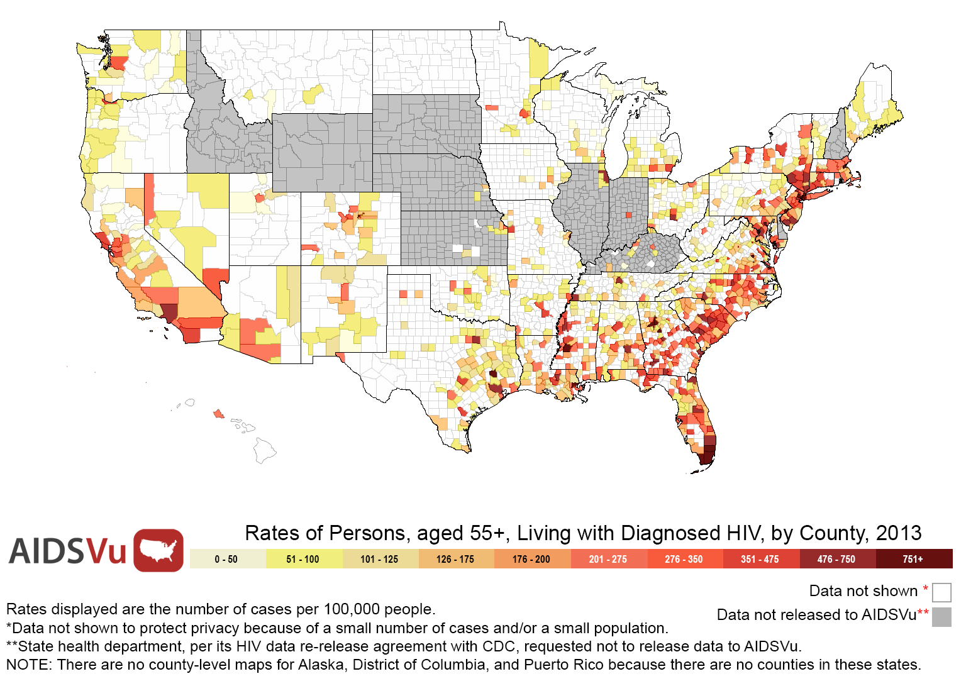
Rates of Persons, aged 55 & older, Living with Diagnosed HIV, by County, 2013
Notes:
Rates of Persons, aged 55 & older, Living with Diagnosed HIV, by County, 2013
This map shows the estimated county-level rates (per 100,000 population) of adults and adolescents aged 55 & older living with diagnosed HIV at the end of 2013.
Data include adults and adolescents living with a diagnosis of HIV infection, regardless of the stage of disease at diagnosis, and have been statistically adjusted to account for reporting delays and missing risk-factor information, but not for incomplete reporting.
Persons living with diagnosed HIV are classified as adult or adolescent based on age at end of 2013.
There are no counties in Alaska, the District of Columbia, and Puerto Rico.
Data were released to AIDSVu in accordance with state health departments' HIV surveillance data re-release agreements with CDC.
More information about AIDSVu's data methods and sources can be found at www.aidsvu.org.

Slide 22
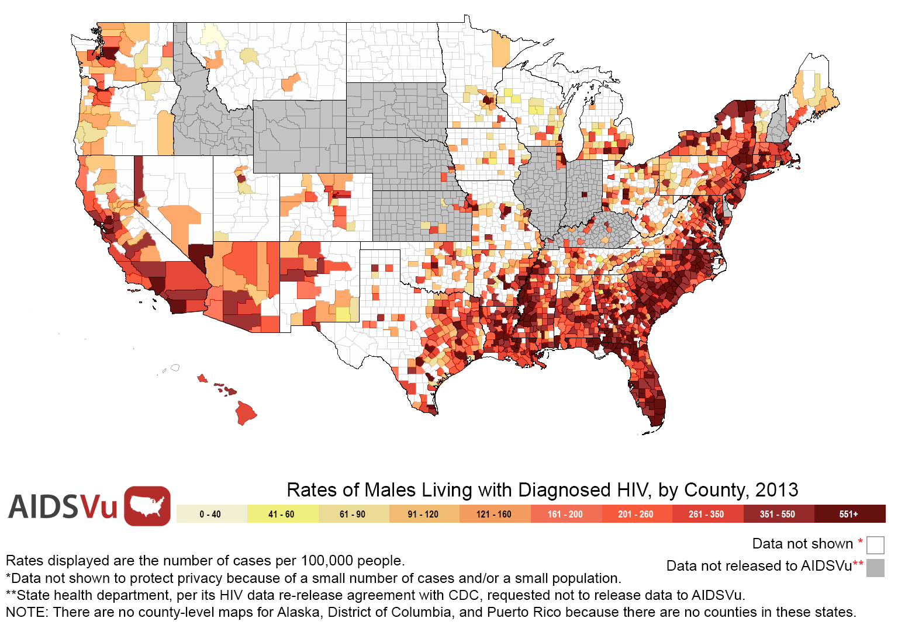
Rates of Males Living with Diagnosed HIV, by County, 2013
Notes:
Rates of Males Living with Diagnosed HIV, by County, 2013
This map shows the estimated county-level rates (per 100,000 population) of male adults and adolescents living with diagnosed HIV at the end of 2013.
Data include adults and adolescents living with a diagnosis of HIV infection, regardless of the stage of disease at diagnosis, and have been statistically adjusted to account for reporting delays and missing risk-factor information, but not for incomplete reporting.
Persons living with diagnosed HIV are classified as adult or adolescent based on age at end of 2013. Sex is defined as sex at birth.
There are no counties in Alaska, the District of Columbia, and Puerto Rico.
Data were released to AIDSVu in accordance with state health departments' HIV surveillance data re-release agreements with CDC.
More information about AIDSVu's data methods and sources can be found at www.aidsvu.org.

Slide 23
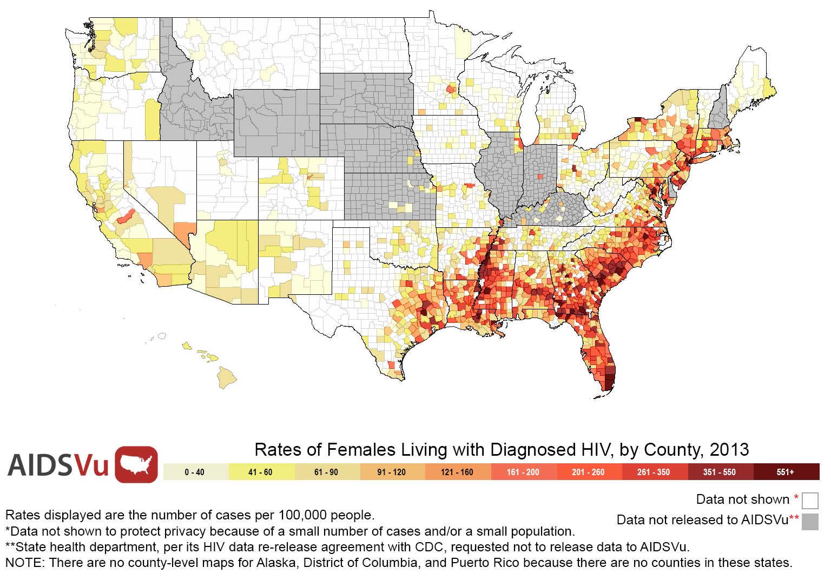
Rates of Females Living with Diagnosed HIV, by County, 2013
Notes:
Rates of Females Living with Diagnosed HIV, by County, 2013
This map shows the estimated county-level rates (per 100,000 population) of female adults and adolescents living with diagnosed HIV at the end of 2013.
Data include adults and adolescents living with a diagnosis of HIV infection, regardless of the stage of disease at diagnosis, and have been statistically adjusted to account for reporting delays and missing risk-factor information, but not for incomplete reporting.
Persons living with diagnosed HIV are classified as adult or adolescent based on age at end of 2013. Sex is defined as sex at birth.
There are no counties in Alaska, the District of Columbia, and Puerto Rico.
Data were released to AIDSVu in accordance with state health departments' HIV surveillance data re-release agreements with CDC.
More information about AIDSVu's data methods and sources can be found at www.aidsvu.org.

Slide 24
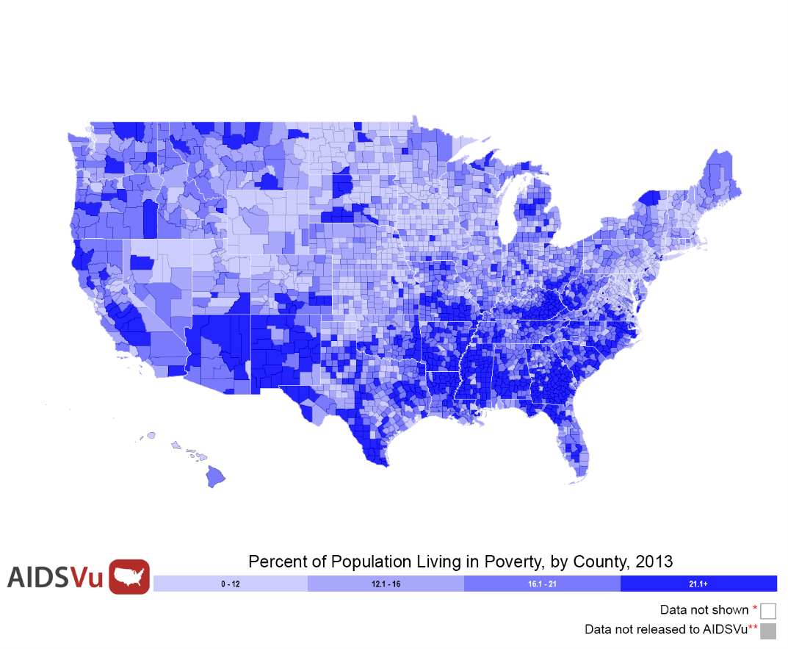
Rates of Persons Living with Diagnosed HIV & Poverty Rates, by County, 2013
Persons Living with Diagnosed HIV
Poverty Rates
Notes:
Rates of Persons Living with Diagnosed HIV & Poverty Rates, by County, 2013
These maps show the estimated county-level rates (per 100,000 population) of adults and adolescents living with diagnosed HIV at the end of 2013 on the left and the percent of the county population living in poverty on the right.
Data include adults and adolescents living with a diagnosis of HIV infection, regardless of the stage of disease at diagnosis, and have been statistically adjusted to account for reporting delays and missing risk-factor information, but not for incomplete reporting.
Persons living with diagnosed HIV are classified as adult or adolescent based on age at end of 2013.
There are no counties in Alaska, the District of Columbia, and Puerto Rico.
HIV data were released to AIDSVu in accordance with state health departments' HIV surveillance data re-release agreements with CDC.
More information about AIDSVu's data methods and sources can be found at www.aidsvu.org

Slide 25
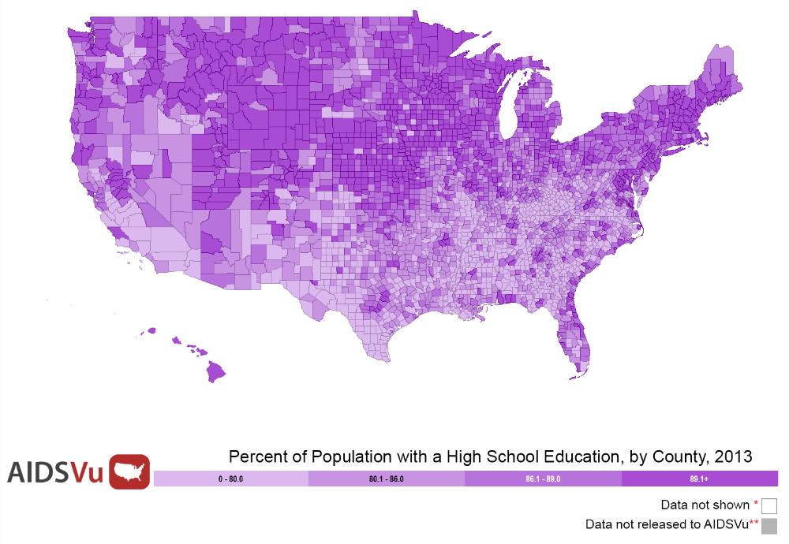
Rates of Persons Living with Diagnosed HIV & Percent with High School Education, by County, 2013
Persons Living with Diagnosed HIV
Percent with High School Education
Notes:
Rates of Persons Living with Diagnosed HIV & Percent with High School Education, by County, 2013
These maps show the estimated county-level rates (per 100,000 population) of adults and adolescents living with diagnosed HIV at the end of 2013 on the left and the percent of the county population with a high school education on the right.
Data include adults and adolescents living with a diagnosis of HIV infection, regardless of the stage of disease at diagnosis, and have been statistically adjusted to account for reporting delays and missing risk-factor information, but not for incomplete reporting.
Persons living with diagnosed HIV are classified as adult or adolescent based on age at end of 2013.
There are no counties in Alaska, the District of Columbia, and Puerto Rico.
HIV data were released to AIDSVu in accordance with state health departments' HIV surveillance data re-release agreements with CDC.
More information about AIDSVu's data methods and sources can be found at www.aidsvu.org

Slide 26
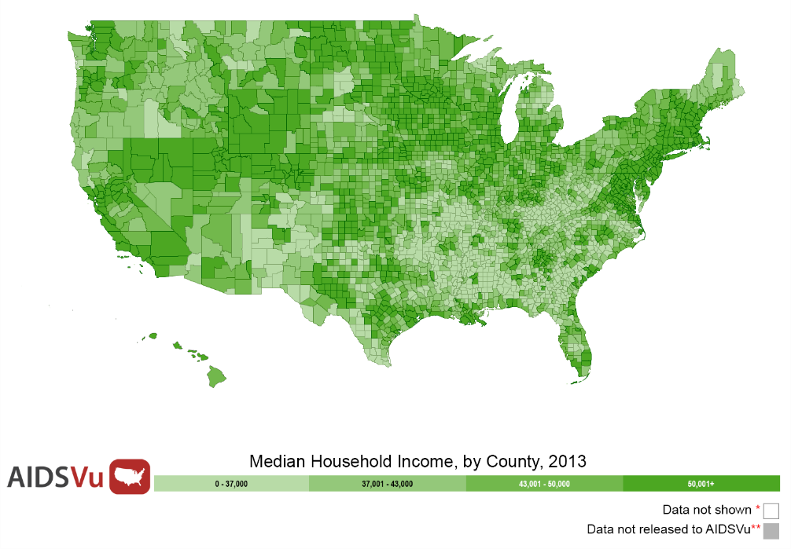
Rates of Persons Living with Diagnosed HIV & Median Household Income, by County, 2013
Persons Living with Diagnosed HIV
Median Household Income
Notes:
Rates of Persons Living with Diagnosed HIV & Median Household Income, by County, 2013
These maps show the estimated county-level rates (per 100,000 population) of adults and adolescents living with diagnosed HIV at the end of 2013 on the left and the median household income at the county level on the right.
Data include adults and adolescents living with a diagnosis of HIV infection, regardless of the stage of disease at diagnosis, and have been statistically adjusted to account for reporting delays and missing risk-factor information, but not for incomplete reporting.
Persons living with diagnosed HIV are classified as adult or adolescent based on age at end of 2013.
There are no counties in Alaska, the District of Columbia, and Puerto Rico.
HIV data were released to AIDSVu in accordance with state health departments' HIV surveillance data re-release agreements with CDC.
More information about AIDSVu's data methods and sources can be found at www.aidsvu.org

Slide 27
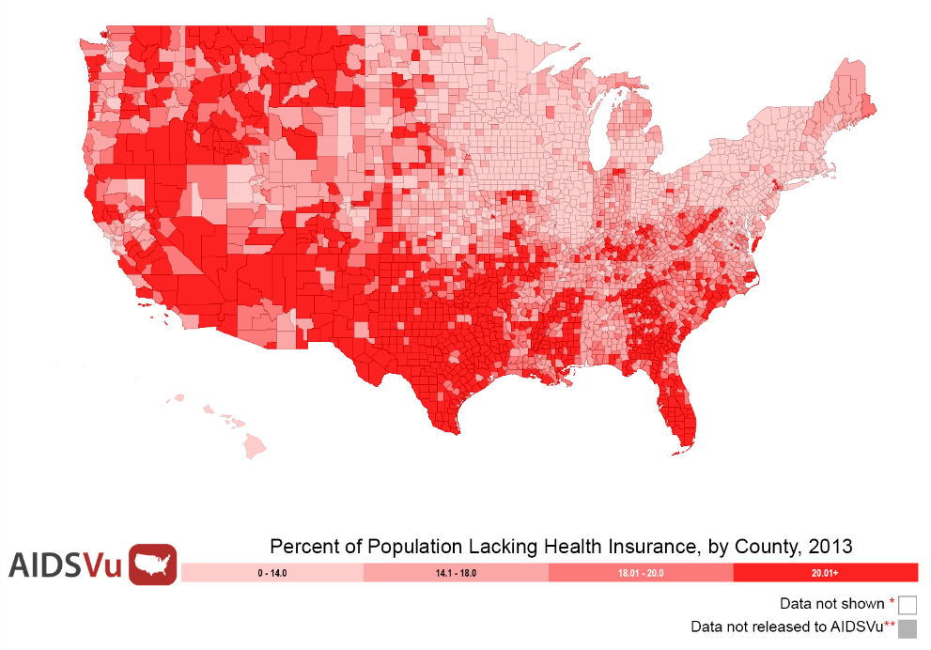
Rates of Persons Living with Diagnosed HIV & Percent of Population without Health Insurance, by County, 2013
Persons Living with Diagnosed HIV
Population without Health Insurance
Notes:
Rates of Persons Living with Diagnosed HIV & Percent of Population without Health Insurance, by County, 2013
These maps show the estimated county-level rates (per 100,000 population) of adults and adolescents living with diagnosed HIV at the end of 2013 on the left and the percent of the county population without health insurance on the right.
Data include adults and adolescents living with a diagnosis of HIV infection, regardless of the stage of disease at diagnosis, and have been statistically adjusted to account for reporting delays and missing risk-factor information, but not for incomplete reporting.
Persons living with diagnosed HIV are classified as adult or adolescent based on age at end of 2013.
There are no counties in Alaska, the District of Columbia, and Puerto Rico.
HIV data were released to AIDSVu in accordance with state health departments' HIV surveillance data re-release agreements with CDC.
More information about AIDSVu's data methods and sources can be found at www.aidsvu.org

Slide 28
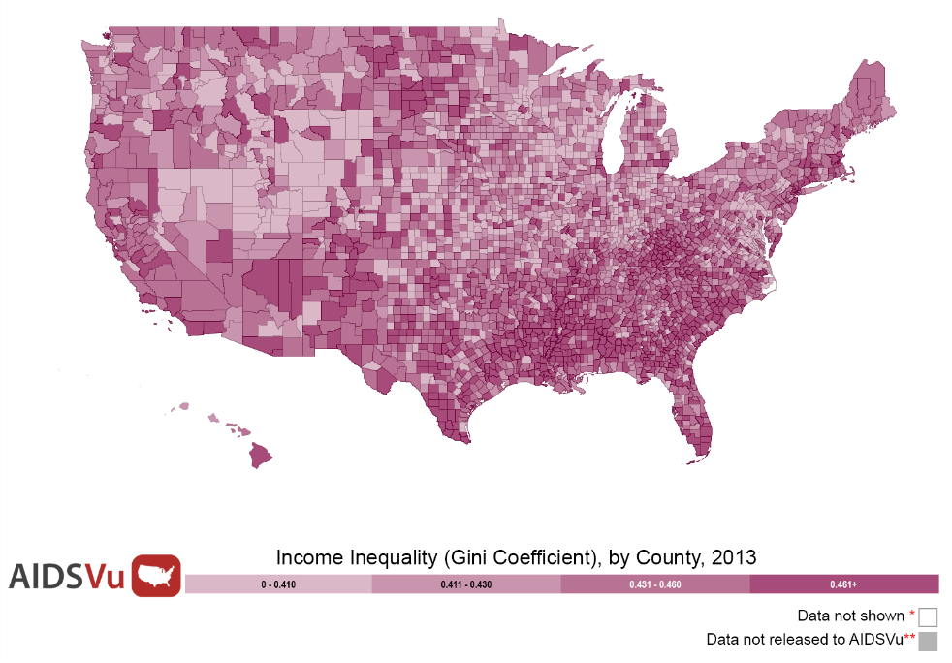
Rates of Persons living with Diagnosed HIV & Income Inequality (Gini Coefficient), by County, 2013
Persons Living with Diagnosed HIV
Income Inequality
Notes:
Rates of Persons Living with Diagnosed HIV & Income Inequality (Gini Coefficient), by County, 2013
These maps show the estimated county-level rates (per 100,000 population) of adults and adolescents living with diagnosed HIV at the end of 2013 on the left and county-level measures of income inequality (Gini coefficient) on the right.
Data include adults and adolescents living with a diagnosis of HIV infection, regardless of the stage of disease at diagnosis, and have been statistically adjusted to account for reporting delays and missing risk-factor information, but not for incomplete reporting.
Persons living with diagnosed HIV are classified as adult or adolescent based on age at end of 2013.
There are no counties in Alaska, the District of Columbia, and Puerto Rico.
HIV data were released to AIDSVu in accordance with state health departments' HIV surveillance data re-release agreements with CDC.
More information about AIDSVu's data methods and sources can be found at www.aidsvu.org

Slide 29
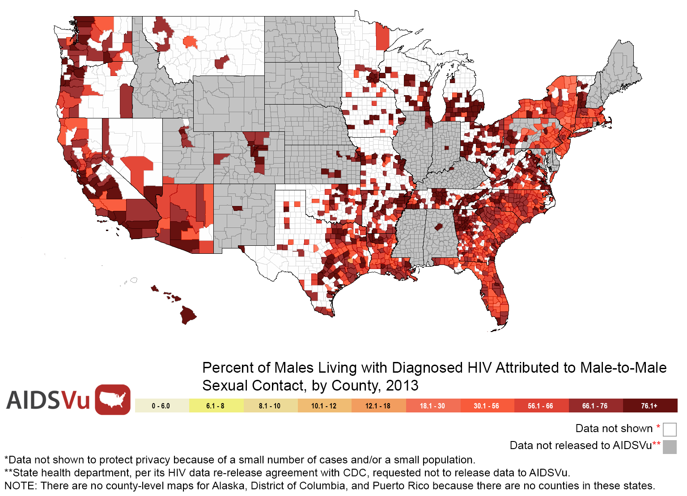
Percent of Males Living with Diagnosed HIV Attributed to Male-to-Male Sexual Contact, by County, 2013
Notes:
Percent of Males Living with Diagnosed HIV for whom Infection is Attributed to Male-to-Male Sexual Contact, by County, 2013
This map shows the state-level percent of all male adults and adolescents living with diagnosed HIV at the end of 2013 for whom infection is attributed to male-to-male sexual contact.
Data include adults and adolescents living with a diagnosis of HIV infection, regardless of the stage of disease at diagnosis, and have been statistically adjusted to account for reporting delays and missing risk-factor information, but not for incomplete reporting.
Persons living with diagnosed HIV are classified as adult or adolescent based on age at end of 2013. Sex is defined as sex at birth.
There are no counties in Alaska, the District of Columbia, and Puerto Rico.
Data were released to AIDSVu in accordance with state health departments' HIV surveillance data re-release agreements with CDC.
More information about AIDSVu's data methods and sources can be found at www.aidsvu.org

Slide 30
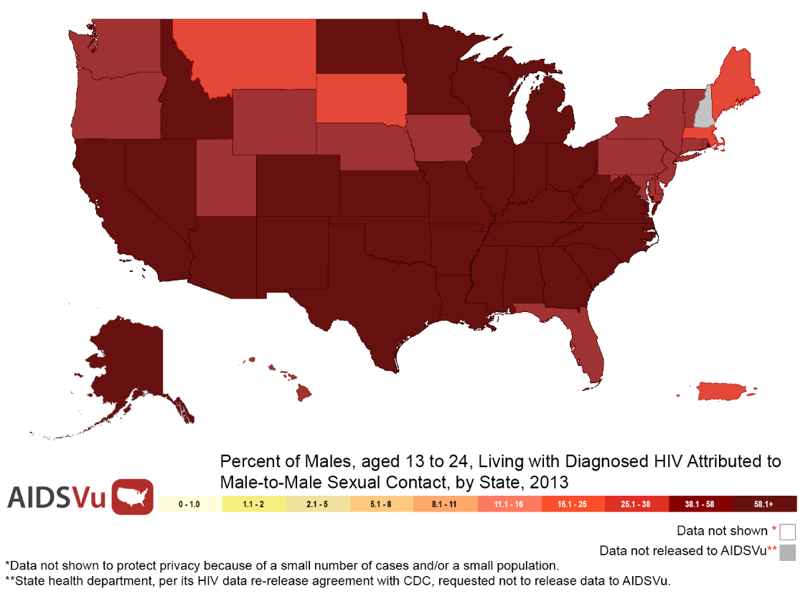
Percent of Males, aged 13 to 24, Living with Diagnosed HIV Attributed to Male-to-Male Sexual Contact, by State, 2013
Notes:
Percent of Males, aged 13 to 24, Living with Diagnosed HIV Attributed to Male-to-Male Sexual Contact, by State, 2013
This map shows the state-level percent of all male adults and adolescents, aged 13 to 24, living with diagnosed HIV at the end of 2013 for whom infection is attributed to male-to-male sexual contact.
Data include adults and adolescents living with a diagnosis of HIV infection, regardless of the stage of disease at diagnosis, and have been statistically adjusted to account for reporting delays and missing risk-factor information, but not for incomplete reporting.
Persons living with diagnosed HIV are classified as adult or adolescent based on age at end of 2013. Sex is defined as sex at birth.
Data were released to AIDSVu in accordance with state health departments' HIV surveillance data re-release agreements with CDC.
More information about AIDSVu's data methods and sources can be found at www.aidsvu.org

Slide 31
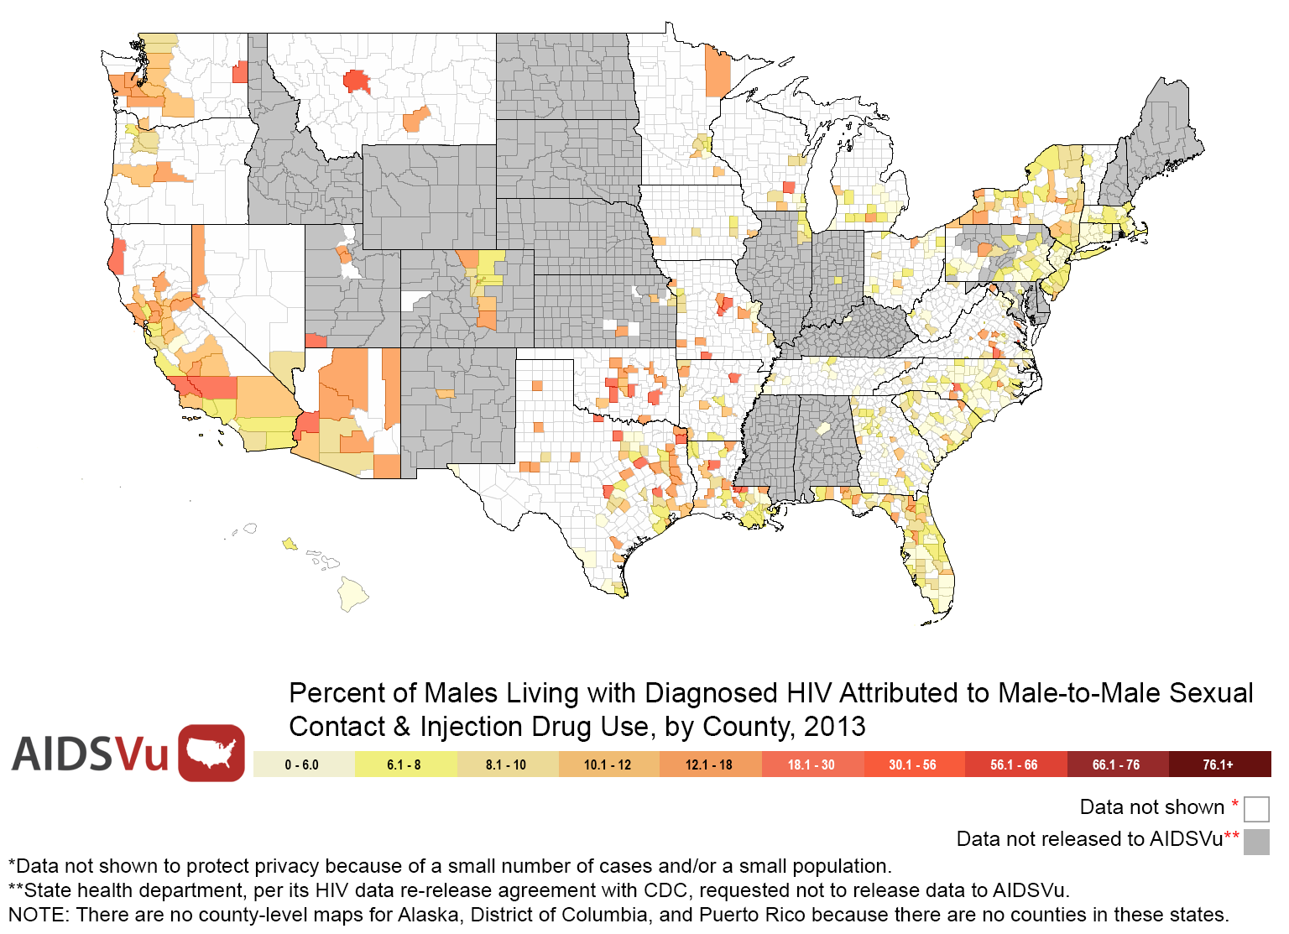
Percent of Males Living with Diagnosed HIV Attributed to Male-to-Male Sexual Contact & Injection Drug Use, by County, 2013
Notes:
Percent of Males Living with Diagnosed HIV for whom Infection is Attributed to Male-to-Male Sexual Contact & Injection Drug Use, by County, 2013
This map shows the state-level percent of all male adults and adolescents living with diagnosed HIV at the end of 2013 for whom infection is attributed to male-to-male sexual contact and injection drug use.
Data include adults and adolescents living with a diagnosis of HIV infection, regardless of the stage of disease at diagnosis, and have been statistically adjusted to account for reporting delays and missing risk-factor information, but not for incomplete reporting.
Persons living with diagnosed HIV are classified as adult or adolescent based on age at end of 2013. Sex is defined as sex at birth.
There are no counties in Alaska, the District of Columbia, and Puerto Rico.
Data were released to AIDSVu in accordance with state health departments' HIV surveillance data re-release agreements with CDC.
More information about AIDSVu's data methods and sources can be found at www.aidsvu.org

Slide 32
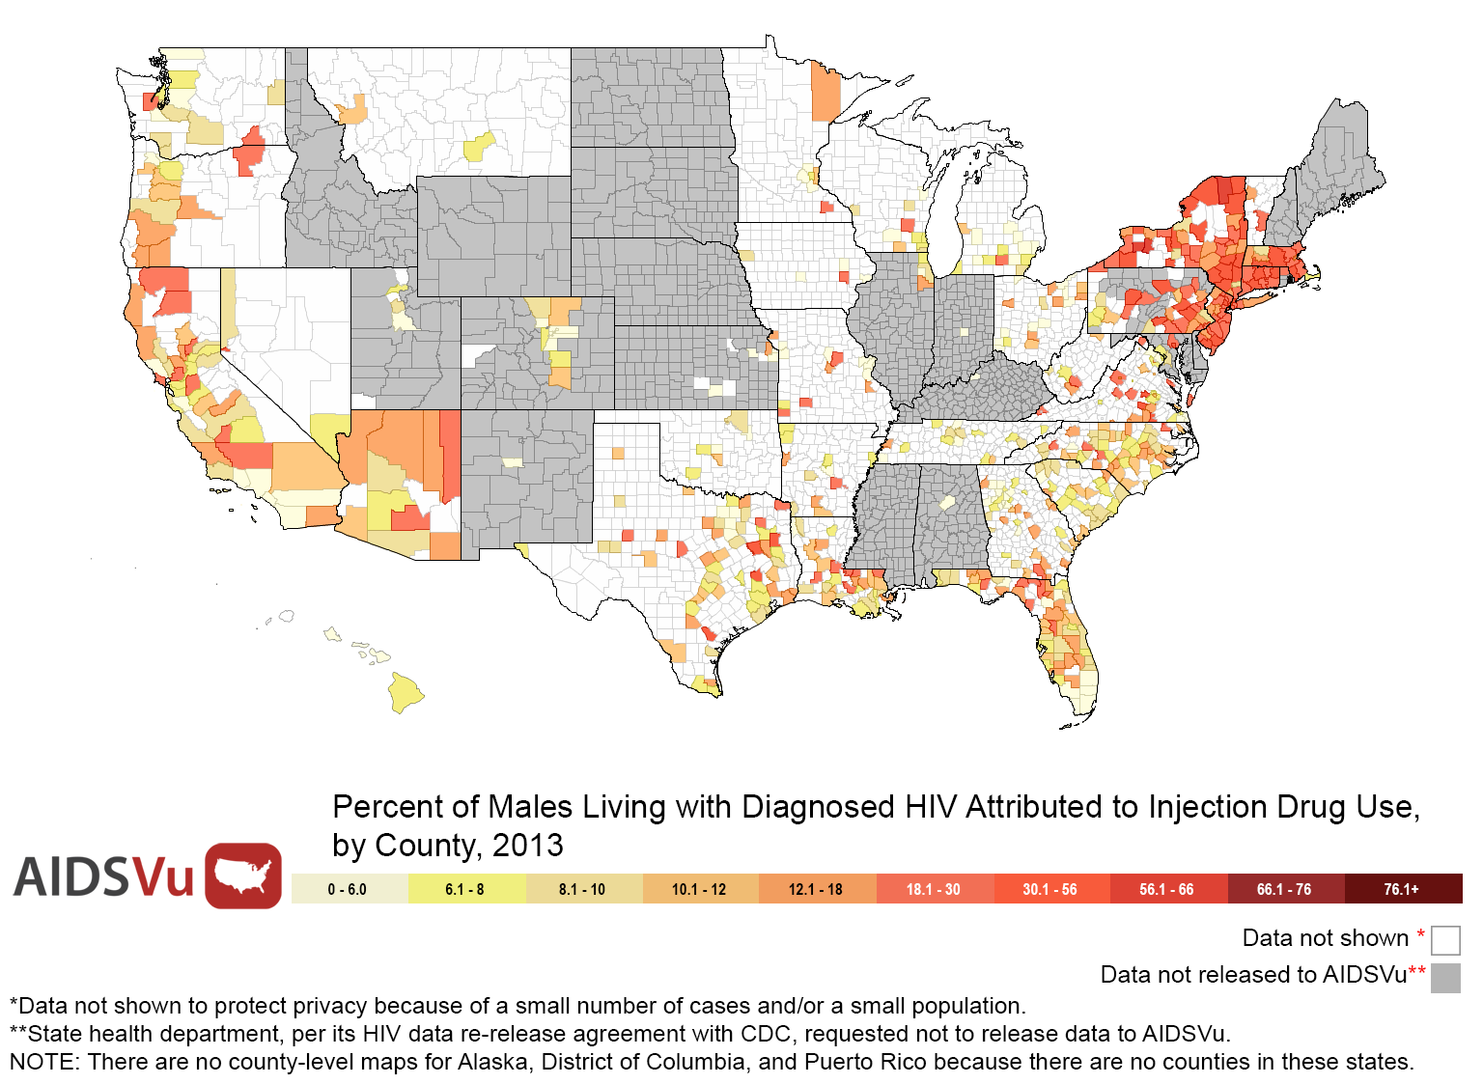
Percent of Males Living with Diagnosed HIV Attributed to Injection Drug Use, by County, 2013
Notes:
Percent of Males Living with Diagnosed HIV for whom Infection is Attributed to Injection Drug Use, by County, 2013
This map shows the state-level percent of all male adults and adolescents living with diagnosed HIV at the end of 2013 for whom infection is attributed to injection drug use.
Persons living with diagnosed HIV are classified as adult or adolescent based on age at end of 2013. Sex is defined as sex at birth.
There are no counties in Alaska, the District of Columbia, and Puerto Rico.
Data were released to AIDSVu in accordance with state health departments' HIV surveillance data re-release agreements with CDC.
More information about AIDSVu's data methods and sources can be found at www.aidsvu.org

Slide 33
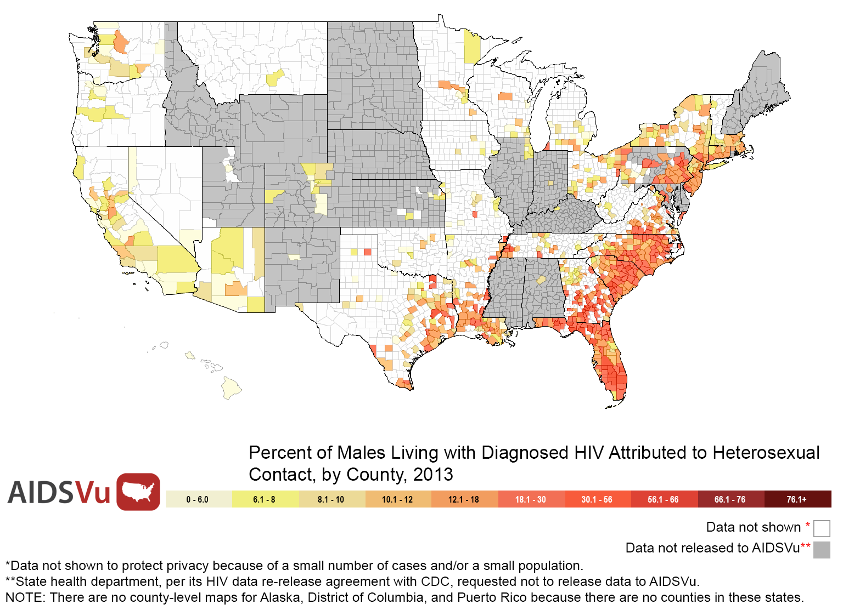
Percent of Males Living with Diagnosed HIV Attributed to Heterosexual Contact, by State, 2013
Notes:
Percent of Males Living with Diagnosed HIV for whom Infection is Attributed to Heterosexual Contact, by County, 2013
This map shows the state-level percent of all male adults and adolescents living with diagnosed HIV at the end of 2013 for whom infection is attributed to heterosexual contact. With respect to mode of transmission, heterosexual contact is defined as heterosexual contact with a person known to have, or to be at high risk for, HIV infection.
Data include adults and adolescents living with a diagnosis of HIV infection, regardless of the stage of disease at diagnosis, and have been statistically adjusted to account for reporting delays and missing risk-factor information, but not for incomplete reporting.
Persons living with diagnosed HIV are classified as adult or adolescent based on age at end of 2013. Sex is defined as sex at birth.
There are no counties in Alaska, the District of Columbia, and Puerto Rico.
Data were released to AIDSVu in accordance with state health departments' HIV surveillance data re-release agreements with CDC.
More information about AIDSVu's data methods and sources can be found at www.aidsvu.org

Slide 34
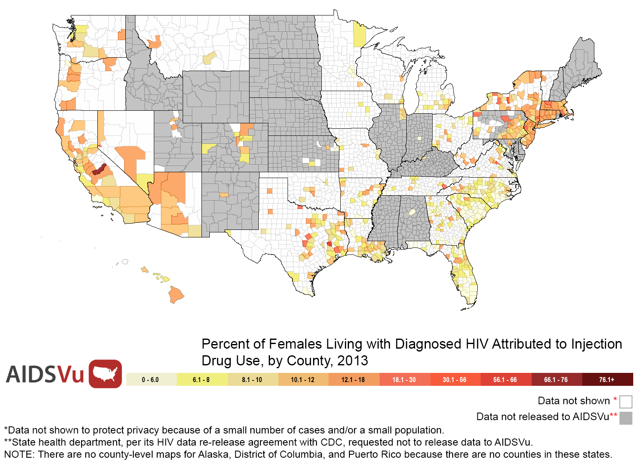
Percent of Females Living with Diagnosed HIV Attributed to Injection Drug Use, by County, 2013
Notes:
Percent of Females Living with Diagnosed HIV for whom Infection is Attributed to Injection Drug Use, by County, 2013
This map shows the County-level percent of all female adults and adolescents living with diagnosed HIV at the end of 2013 for whom infection is attributed to injection drug use.
Data include adults and adolescents living with a diagnosis of HIV infection, regardless of the stage of disease at diagnosis, and have been statistically adjusted to account for reporting delays and missing risk-factor information, but not for incomplete reporting.
Persons living with diagnosed HIV are classified as adult or adolescent based on age at end of 2013. Sex is defined as sex at birth.
There are no counties in Alaska, the District of Columbia, and Puerto Rico.
Data were released to AIDSVu in accordance with state health departments' HIV surveillance data re-release agreements with CDC.
More information about AIDSVu's data methods and sources can be found at www.aidsvu.org

Slide 35
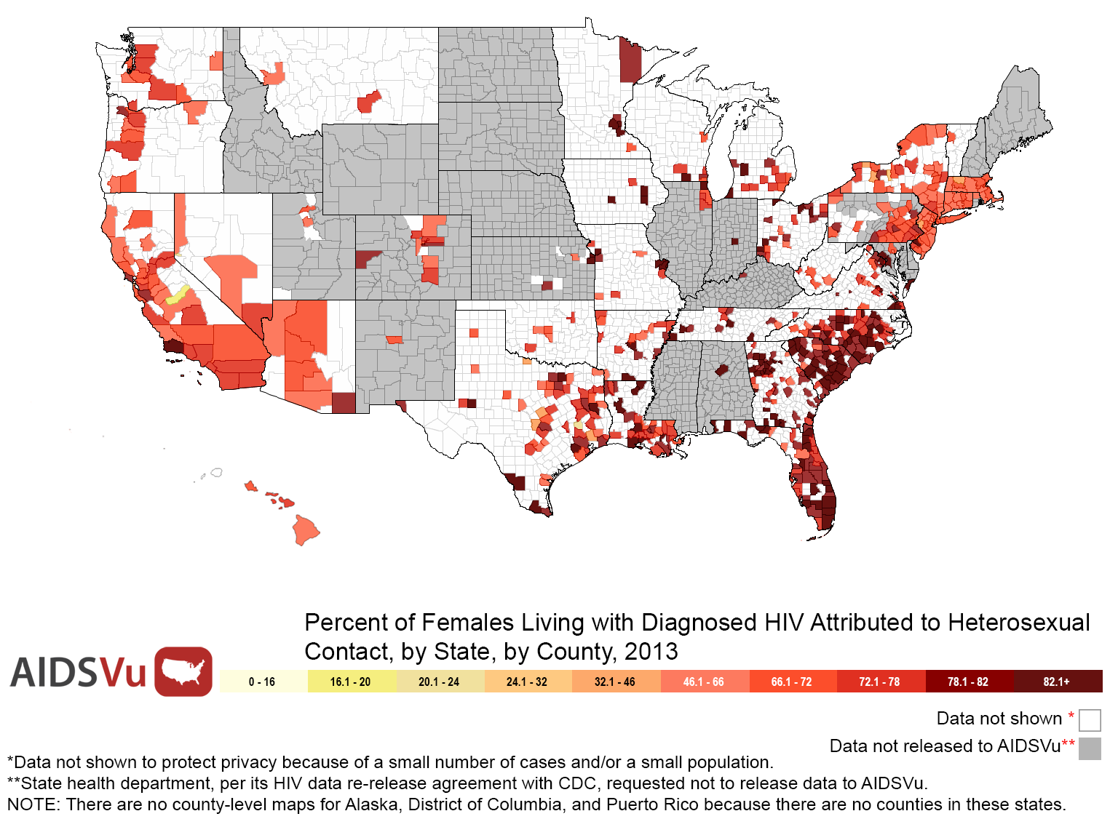
Percent of Females Living with Diagnosed HIV for Attributed to Heterosexual Contact, by County, 2013
Notes:
Percent of Females Living with Diagnosed HIV for whom Infection is Attributed to Heterosexual Contact, by County, 2013
This map shows the County-level percent of all female adults and adolescents living with diagnosed HIV at the end of 2013 for whom infection is attributed to heterosexual contact. With respect to mode of transmission, heterosexual contact is defined as heterosexual contact with a person known to have, or to be at high risk for, HIV infection.
Data include adults and adolescents living with a diagnosis of HIV infection, regardless of the stage of disease at diagnosis, and have been statistically adjusted to account for reporting delays and missing risk-factor information, but not for incomplete reporting.
Persons living with diagnosed HIV are classified as adult or adolescent based on age at end of 2013. Sex is defined as sex at birth.
There are no counties in Alaska, the District of Columbia, and Puerto Rico.
Data were released to AIDSVu in accordance with state health departments' HIV surveillance data re-release agreements with CDC.
More information about AIDSVu's data methods and sources can be found at www.aidsvu.org

Slide 36
Caveats & Limitations of AIDSVu Maps
Data on AIDSVu may differ from data released in state and local HIV surveillance reports.
All state and county, and some city-level maps are inclusive of incarcerated persons and should be interpreted with caution.
AIDSVu maps do not reflect undiagnosed cases.
Caution should be exercised when comparing maps because the scales change when viewing data overall and by race/ethnicity, sex, and age group breakdowns.
Notes:
HIV prevalence data on AIDSVu may differ slightly from data released by state and local HIV surveillance programs because of different analysis criteria and because data released from CDC has been de-duplicated on a national basis.
Caution should be exercised when interpreting county, ZIP Code, census tract, and neighborhood data as these statistics can be inclusive of incarcerated persons and their inclusion may artificially inflate the actual rate and case count when an institution is housed within it. See AIDSVu’s Data Methods for details regarding this limitation.
AIDSVu maps do not reflect undiagnosed cases.
Caution should be exercised when comparing maps because the scales change when viewing data overall and by race/ethnicity, sex, and age group breakdowns.
Comparisons should not be made between AIDSVu’s state and county maps and its ZIP Code/census tract/neighborhood maps because the data sources are different.

Slide 37
Additional Resources
For maps of state- and county-level data that include HIV and other sexually transmitted infections (STIs), visit the CDC’s National Center for HIV/AIDS, Viral Hepatitis, STD and TB Prevention (NCHHSTP) Atlas: www.cdc.gov/nchhstp/atlas/
For more information about HIV prevention, visit: www.cdc.gov/hiv/strategy/hihp/ and http://aids.gov/federal-resources/hiv-aids-programs/prevention-programs/index.html
For additional health facts and HIV/AIDS policy fact sheets, visit the Kaiser Family Foundation’s website: www.kff.org/hivaids/index.cfm

Slide 38
Contact AIDSVu
More map views, downloadable maps and additional resources are available online at www.aidsvu.org.
For more information about AIDSVu, including information about custom map views and images, please email info@aidsvu.org.

