Slide 1
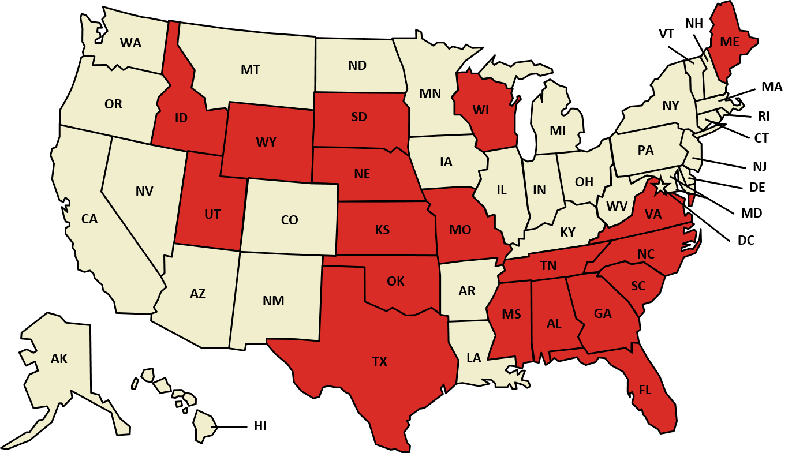
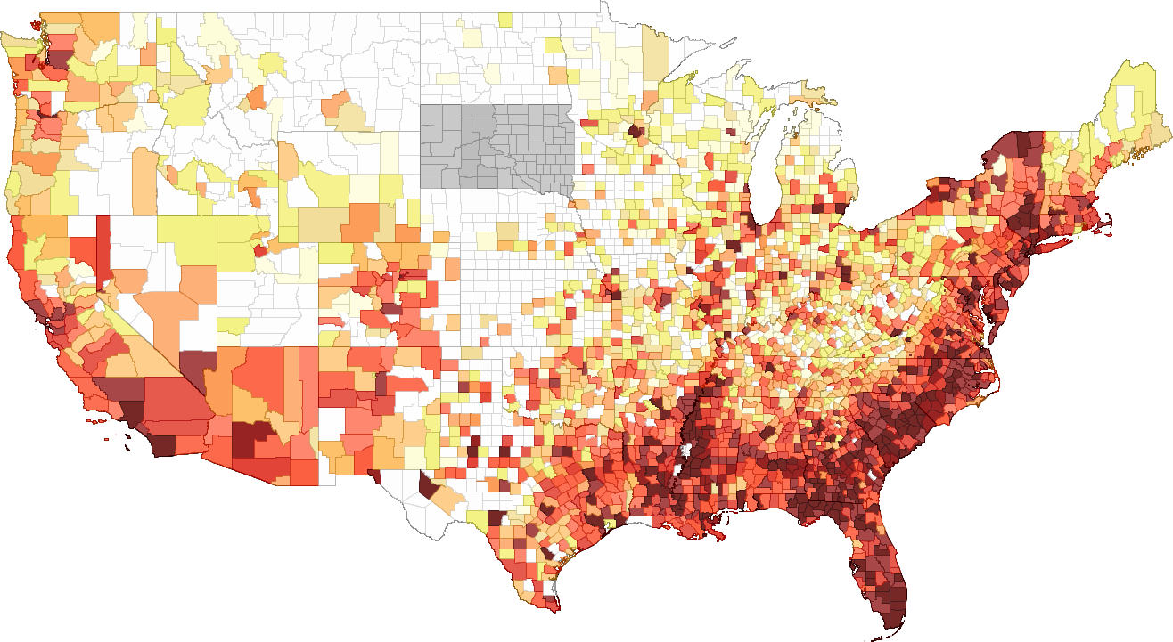
HIV PREVALENCE AMONG NON-MEDICAID EXPANSION STATES
CURRENT STATUS OF STATE MEDICAID EXPANSION DECISIONS PERSONS LIVING WITH AN HIV OR AIDS DIAGNOSIS, 2013
411+
Rates of Persons Living with Diagnosed HIV, 2013
NOT ADOPTING AT THIS TIME (19 STATES)
ADOPTED (32 STATES INCLUDING DC)
0 to 40 |  |  | 91 to 110 |  |  | 261 to 410
41 to 60 61 to 70 71 to 90 |  |  | 111 to 140 141 to 190 191 to 260 |  |  | 411+ Data not shown* Data not released to AIDSVu **
“
Nearly 60,000 people living with HIV live in states not moving forward with Medicaid expansion…About 70 percent…earn too little to qualify for ﬁnancial help to buy insurance in the marketplaces created by the health law.
”
SOURCE: “Status of State Action on the Medicaid Expansion Decision,” KFF State Health Facts, updated July 07, 2016. http://kff.org/health-reform/state-indicator/state-activity-around-expanding-medicaid-under-the-affordable-care-act/#
es/

